Slide 1
Three Steps and a Hop A Foodborne Illness Outbreak Investigation TABLE TOP EXERCISE
Developed by the
Colorado Integrated Food Safety Center of Excellence
Notes:
Based on real outbreak at El Paso County Public Health. Modified slightly for educational purposes.

Slide 2
After completing this case study, students should be able to:
Explain what constitutes a foodborne illness outbreak.
Describe the steps in a foodborne illness outbreak investigation.
List different outbreak investigation team members and their roles and responsibilities.
Establish and apply an outbreak case definition.
Describe outbreak-associated cases by time, person, and place.
Create and interpret an epidemic curve.
Describe the types of epidemiological studies used during an outbreak investigation.
Calculate and interpret measures of association.
Describe the purpose of conducting an environmental assessment.
Define and give examples of contributing factors.
Explain how to summarize and share outbreak investigation findings.
Notes:
DON’T read this slide

Slide 3
Initial Complaint Call
At 12:55pm on Monday, March 14th an epidemiologist from the El Paso County Public Health Communicable Disease Program received a phone call from the president of a Polka Dance Club, Joy Johnson. Joy was calling on behalf of dance club members who reported becoming ill following the annual Hippety-Hop Dance Festival.
At your table, work through questions 1-3.
Stop at the bottom of page 4.
Optional: use the timeline on page 20 to track important dates.

Slide 4
Initial Investigation
What additional information should you request from Joy Johnson? What questions would you ask her?
Do you think this represents an outbreak? Why or why not?
What next steps would you take?
Notes:
Group report back/discussion.

Slide 5
After determining that an outbreak investigation should be conducted, you decided to contact some of the individuals from Joy’s list to learn more about their illness and the event, and ask if they would be willing to submit a stool sample for testing. You notified the state health department and the public health lab expects samples. You also called a meeting with individuals on your team to inform them of the upcoming outbreak investigation.
At your table, work through questions 4-6.
Stop at the bottom of page 7.

Slide 6
Who should be part of the outbreak investigation team? Briefly describe each role.
What questions would you ask during initial case interviews?
Develop a case definition for this outbreak.

Slide 7
Epidemiologic Study
A case was defined as a person having diarrhea (at least 3 or more loose stools in a 24-hour period) after attending the Friday night welcome dinner at the Hippety-Hop Dance Festival with onset of illness from March 11-13.
Your team decided to conduct an epidemiologic study to determine which exposure made people ill.
At your table, work through questions 7-8.
Stop at the bottom of page 9.

Slide 8
What type of epidemiologic study should you conduct to investigate this outbreak? Why?
Apply the case definition to the line list of attendees reporting symptoms. How many outbreak-associated cases are there?

Slide 9
Transmission and Pathogen
Based on the case definition, you have determined a total of 26 outbreak-related cases. Your next step was to build an epidemic curve to provide a visual representation of the outbreak.
At your table, work through questions 9-10.
*Graph paper on page 21*
Stop at the bottom of page 11.

Slide 10
Build the epidemic curve for this outbreak. What pattern does the epidemic curve show?
What is the median incubation period for this illness?
Use the information collected thus far and the symptoms and onset table (Appendix B) to determine a suspect etiology. Justify your answer.

Slide 12
Identifying Food Vehicle
You notify the state laboratory of the suspected exposure to bacterial toxins including Clostridium perfringens and Bacillus cereus. Similar to your investigation findings, bacterial toxins cause lower gastrointestinal symptoms such as diarrhea and cramps, and have a shorter onset time that match the incubation period.
The illness incubation period and epidemic curve pattern further supported your hypothesis that food from the Friday welcome dinner was the point source cause of the outbreak. Based on the interviews with persons who attended the Friday night dinner, you collected their exposure information and performed statistical analysis.
At your table, work through questions 11-12.
*For Questions 11-12, you may want to divide up exposures at your table.*
Stop at the bottom of page 14.

Slide 13
Construct 2x2 tables for exposure to the Friday night dinner and foods including brisket, gravy, mashed potatoes, coleslaw.
What is the appropriate measure of association for this study design?
Use the 2x2 tables to calculate the measure of association for the dinner and each food. Interpret the risk ratios associated with eating the brisket, gravy, and coleslaw.
Based on the risk ratios, are any foods implicated by the cohort study? If yes, which one(s)?

Slide 14
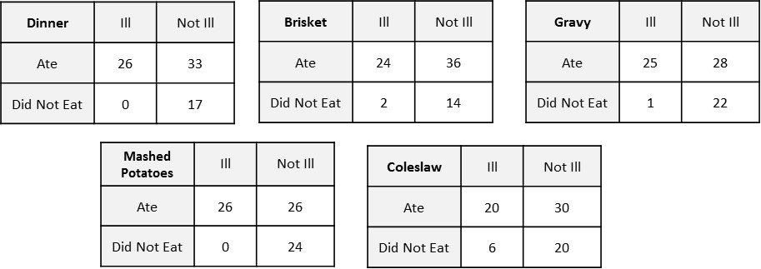

Slide 15
Risk Ratios
Dinner: (26/59) / (0/17) = undefined
(p-value* = 0.002)
Brisket: (24/60) / (2/16) = 3.2
(p-value = 0.07)
Gravy: (25/53) / (1/23) = 10.8
(p-value=0.0008)
Mashed potatoes: (26/52) / (0/24) = undefined
(p-value <0.0001)
Coleslaw: (20/50) / (6/26) = 1.7
(p-value =0.07)

Slide 16
Environmental Assessment
The environmental health team conducted an environmental assessment. An environmental assessment is defined as a systematic, detailed, science-based evaluation of environmental factors that contributed to the transmission of disease in an outbreak. In this outbreak investigation, the environmental health investigators planned to conduct an environmental assessment at the Catering by Charlotte facility. They evaluated a variety of policies, processes, and critical violations to help explain how food contamination, pathogen survival, or pathogen proliferation caused disease transmission.
At your table, work through questions 13-15.
Stop at the bottom of page 17.

Slide 17
What activities would the environmental health staff perform during an environmental assessment?
What are some of the contributing factors that may have increased the risk of foodborne illness from the Friday dinner food or drink?
Relate the environmental assessment findings to your suspicions about the cause of the outbreak.

Slide 18
Communication
After conducting the environmental assessment, confirming the pathogen, and identifying the contributing factors, you ordered a cease and desist on Catering by Charlotte until she obtains the proper licensing. Your final steps in concluding the investigation were to write the outbreak report and communicate your findings to the outbreak stakeholders.
At your table, work through questions 16-17.
Stop at the bottom of page 18.

Slide 19
To whom should you communicate your findings?
What communication and collaboration between outbreak team members practiced during this table top exercise will you apply to your agency’s next outbreak?

Slide 20
The End.
You wrap up the outbreak by communicating your findings in an outbreak report for the state health department and a NORS report for the Centers for Disease Control and Prevention. The environmental health program issued a cease and desist order to Catering by Charlotte until she obtains the proper license. You also presented your findings to Joy, President of the Polka Dance Club. Joy asked many questions regarding best practices of finding and hiring a licensed caterer, which you answer in hopes of helping to prevent any future illnesses at the Hippety-Hop Festival. Joy invites your investigation team to attend the Hippety-Hop Festival next year.

