Slide 1
Fifteenth Meeting of the HB 21-1317 Scientific Review Council March 12, 2024

Slide 2
Opening Remarks, Introductions and Welcome; Updates on Conflict of Interest Christopher E. Urbina, MD, MPH Chair, HB 21-1317 Scientific Review Council

Slide 3
Scientific Review Council Members
Member | Role on Council | Affiliation(s)
Chris Urbina, MD, MPH (Chair) | Preventive medicine specialist (or preventive medicine public health professional) | Pueblo Department of Public Health and Environment; Former Director of CDPHE
Gregory Kinney, PhD, MPH | Epidemiologist | Colorado School of Public Health
Kelly Knupp, MD | Physician familiar with the administration of medical marijuana pursuant to current state laws to those aged zero to seventeen | University of Colorado School of Medicine
Kennon Heard, MD | Medical Toxicologist | University of Colorado School of Medicine
Archana Shrestha, MD | Neurologist | University of Colorado School of Medicine
Erica Wymore, MD, MPH | Pediatrician | University of Colorado, School of Medicine
Paula Riggs, MD | Psychiatrist | University of Colorado, School of Medicine
Susan Calcaterra, MD, MPH | Internal medicine physician (or other specialist in adult medicine) | University of Colorado School of Medicine
Joseph Schacht, PhD | Licensed Substance Abuse Disorder Specialist | University of Colorado School of Medicine
Kent Hutchison, PhD | Neuropsychopharmacologist | University of Colorado School of Medicine
Lesley Brooks, MD | Medical professional (or public health professional) who specializes in racial and health disparities and systemic inequalities in health care and medicine | North Colorado Health Alliance; SummitStone Health Partners

Slide 4
Cannabis Research & Policy Project Team Members
Member | Sub-Team
Charlene Barrientos Ortiz | Education Campaign
Lisa Bero, PhD | Systematic Review
Ashley Brooks-Russell, PhD, MPH | Subject Area Expertise
Paige Buchanan-Hall, BA | Education Campaign
Meghan Buran, MPH | Administration
Annie Collier, PhD | Education Campaign
Colleen Keenan, MPH | Education Campaign
Jenn Leiferman, PhD | Education Campaign
Louis Leslie, BA | Systematic Review
Tianjing Li, MD, PhD, MHS | Systematic Review
Jean-Pierre Oberste, BA | Systematic Review
Christi Piper, MLIS | Systematic Review
Thanitsara Rittiphairoj, MD, MPH | Systematic Review
Jonathan Samet, MD, MS | Administration
Neeloofar Soleimanpour, MPH | Administration
Greg Tung, PhD, MPH | Administration, Subject Area Expertise
Sam Wang, MD | Subject Area Expertise
Tsz Wing Yim, MPH | Systematic Review

Slide 5
Review of Agenda Christopher E. Urbina, MD, MPH Chair, HB 21-1317 Scientific Review Council

Slide 6
Scientific Review Council Meeting Agenda
11:00 AM | Opening Remarks, Introductions and Welcome, Updates on Conflict of Interest | Chris Urbina
11:05 AM | II. Review of Agenda and Meeting Minutes (2/26/24) | Chris Urbina
11:10 AM | III. Overview of Cannabis Research & Policy Team’s Overall Progress | Jon Samet & Greg Tung
11:25 AM | IV. Discussion of “Policy Approaches to High Concentration Cannabis and THC Concentrates” | Chris Urbina & Jon Samet
12:00 PM | V. Educational Campaign Presentation and Discussion: Update of Ongoing Activities | Annie Collier
12:25 PM | VI. Educational Campaign Presentation and Discussion: New Activities | Annie Collier
12:55 PM | VII. Next Steps & Closing Remarks | Jon Samet & Chris Urbina

Slide 7
Review of Meeting Minutes Christopher E. Urbina, MD, MPH Chair, HB 21-1317 Scientific Review Council

Slide 9
Overview of Progress by Cannabis Research & Policy Team Jonathan Samet, MD, MS Professor & Former Dean, Colorado School of Public Health Greg Tung, PhD, MPH Associate Professor, Colorado School of Public Health

Slide 10
Overall Progress
Monthly newsletter and timeline posted on our project website; next update will be posted at the end of March 2024.
Planning Methods Workshop for June 2024. First round of invites were sent out.
Scheduled Continuing Medical Education Event with Children's Hospital for Pediatric & OBGYN Providers
Working with the Department of Psychiatry on provider educational activities
Reports under development
Mass-Media Behavioral Interventions
Modern Modalities in Behavioral Interventions
Mental Health Systematic Review
Respiratory Review
Policy Translation
Funding Bias
Educational Campaign

Slide 11
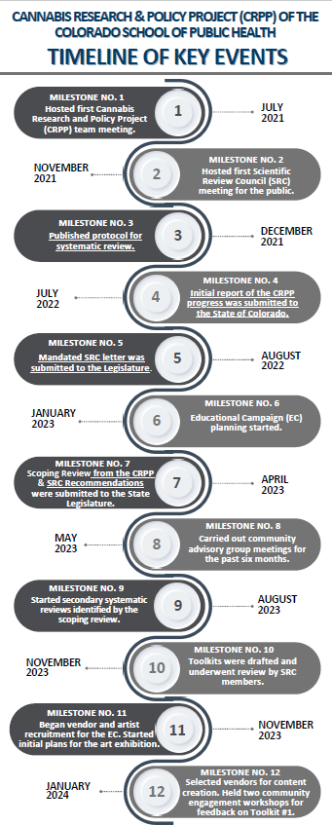
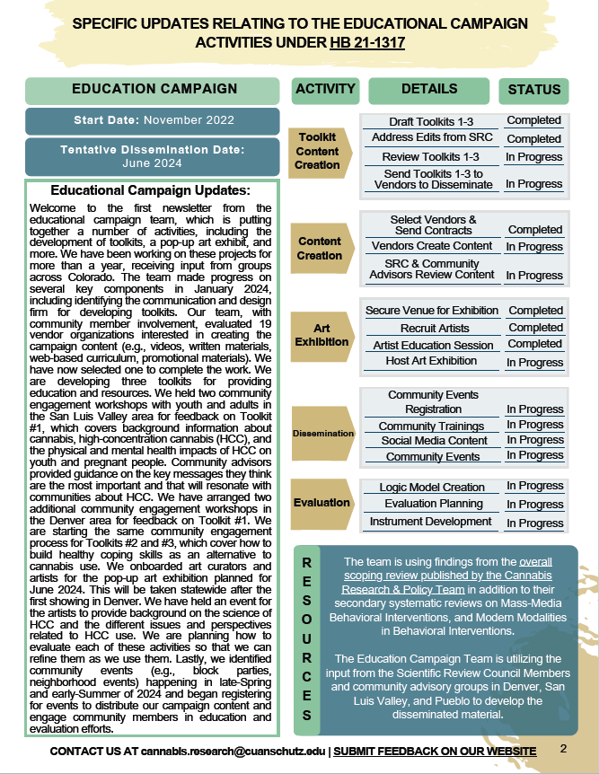
Monthly Newsletter & Timeline

Slide 12
Advancing Methods Workshop in Cannabis Research
Who: Planning committee sent out invitations on the first of March
Areas of Expertise: Surveillance, Policy, Clinical Toxicology, Industry Expert, Research Methodology, Psychiatry, Pharmacology, RAND, Biomarkers, & Field Research
What: Two day workshop to develop a draft report
When: June 2024, poll was sent to finalize date with attendees.
Where: Boulder, CO
Why: Responding to the need for stronger research, (We) are hosting a meeting to advance methods in cannabis research. The aim of the meeting is to develop recommendations to improve the standardization, generalizability and methodological rigor of the science.

Slide 13
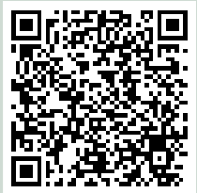
Continuing Medical Education for Pediatric & OBGYN Providers
Topics to be discussed:
Background of cannabis pharmacology, current marketing landscape, risk communication, evidence on health impacts of high concentration cannabis
May 15, 2024, at Nighthorse Campbell – Shore Family Forum, Anschutz Medical Campus
Basis for development of educational materials
Scan Here to Register:
https://ce.childrenscolorado.org/content/cannabis-update-2024#group-tabs-node-course-default1

Slide 14
CU Department of Psychiatry
Development of resources and trainings for mental health providers related to HCC
CME Event for Mental Health Providers – Fiscal Year 2025
Potential partnership with the communication and education campaign
Outreach to K-12 educators

Slide 15
Policy Approaches to High Concentration Cannabis and THC Concentrates Christopher E. Urbina, MD, MPH Chair, HB 21-1317 Scientific Review Council Jonathan Samet, MD, MS Professor & Former Dean, Colorado School of Public Health

Slide 16
Measures taken should have the following critical objectives:
Protect the fetus, infants, and toddlers from any exposure to high concentration products.
Limit contact of adolescents and young adults up to at least age 21 with high concentration products.
Make certain that those individuals with mental health problems and their care providers are aware that high concentration products may pose a threat.
Assure that users of high concentration products understand that health risks of these products are uncertain.
Shift the distribution of sales towards lower concentrations generally while research continues to better characterize the effects of high concentration products.
Conduct real-time monitoring of the cannabis marketplace and consumption patterns of the various population groups of interest and evaluate potential impacts on health outcomes.

Slide 17
SRC Discussion on Policy Recommendations Christopher E. Urbina, MD, MPH Chair, HB 21-1317 Scientific Review Council

Slide 18
SRC Discussion on Policy Recommendations
Ask to the SRC:
Do (we) agree with High Concentration recommendations written in the Policy Paper with no prioritization or highlights?

Slide 19
SRC Discussion on Policy Recommendations
Does the SRC want to make specific recommendations regarding High Concentration THC for fetus, infants and toddlers, adolescents, pregnant people and those with mental health conditions?
Focus on educational measures to avoid use of high concentration products in these populations
Reenforce need to continue child resistant packaging, locked storage, dose limitations and restrictions on labeling and advertisement of all concentrations of cannabis
Recommend higher taxation or sales limits of high concentration products
Require cannabis industry to increase user education of the potential risks of high concentration products while acknowledging uncertainty of scientific evidence (currently all cannabis concentrations have limited safety recommendations)
Recommend real-time monitoring of the cannabis marketplace and consumptions patterns by CDPHE and the Colorado Marijuana Enforcement Division
Continue the ongoing review of the scientific literature of all cannabis research
Other

Slide 20
Educational Campaign Update Annie Collier, PhD Associate Professor, Colorado School of Public Health

Slide 21
Educational Campaign Highlights
The focus of the educational campaign is to decrease consumption of high-concentration cannabis (HCC) among youth, young adults, and pregnant and post-partum people
We are accomplishing this through an integrated and multimodal communication and education campaign that involves collaboration and contracting with a public health-oriented media firm, CSU, UNC, Children's Hospital, and other partners
These partnerships expand the scale, scope, and geographic reach of these efforts throughout Colorado
We have strong community engagement and evaluation built into all activities
All proposed activities were selected with the vision of expansion in future HCC efforts

Slide 22
Ongoing Community Engagement
Bi-monthly community engagement workshops in San Luis Valley, Pueblo, & Denver
Bi-weekly Rapid Response Team feedback regarding campaign content & activities
Additional guidance including cultural competency and social justice training

Slide 23
Projects - Summary
Organization | Activities & Deliverables
**Initium Health – Marketing Content Development | Six videos, six written products, three online educational modules, program branding
Initium Health – Social Media Campaign | Program website; content across relevant social media platforms; podcast on topic of HCC
Initium Health – Integrated Media Campaign | Integrated advertising campaign across various channels (e.g., print, television, radio, social media); supports all relevant initiatives
**Shadow Consulting – Art Exhibitions HEAR|SAY | Two art exhibitions (adult and youth) and mural, printed catalog, display panels, accompanying events (e.g., artist talks, youth performances)
Community Partner Training (CSPH) – Motivational Interviewing Trainings | Six, 2-hour trainings on the basics of motivational interviewing & one, 4-week online course on the details of motivational interviewing
Clinic Chat, LLC – HCC Education via AI Chatbots | Artificial intelligence (AI) chatbot on the topic of HCC, delivered through web-based conversations and telephone- and What’s App-based text messages in English and Spanish
University of Northern Colorado – College Educational Campaign | Development of HCC screening and educational materials and resources disseminated through UNC’s Office of Health Promotion; Mindfulness training certification for UNC’s faculty that focuses on positive alternatives to cannabis consumption
Colorado State University – Young Adult Educational Campaign | Social marketing campaign targeted at college-aged youth in Larimer and Weld counties
CU Department of Psychiatry – CME Events | Educator trainings on HCC impact and how to have conversations

Slide 24
Initium Health #1: Marketing Content Development (contract in place)
Target Audience
Anticipated Deliverables
Relevant Dates
Evaluation Metrics
Key Site Contacts
Youth under the age of 21
6 videos
Awareness of cannabis & HCC
Cannabis & HCC use behaviors
Coping behaviors
Content outlines – March 2024
James Corbett, Principal
Pregnant and parenting people
Parents and trusted adults of youth
6 written products
3 online educational modules
Branding – logo, tagline
Content drafts – April 2024
Engagement metrics (e.g., impressions per channel)
Elise Plakke, Executive Creative Director
Devin Hatchett, Public Health Consultant & Communications Specialist
Notes:
Clarify dates with Dannon

Slide 25
Science Informed Art Exhibition: HEAR|SAY (contract in place)
Target Audience
Youth under the age of 21
Anticipated Deliverables
Artist education training sessions (youth & adults)
John Tannous, Shadow Consulting
Artist Education – February – March 2024
Awareness of cannabis & HCC
Relevant Dates
Evaluation Metrics
Key Site Contacts
Parents and trusted adults of youth
Art exhibitions (youth & adults)
Art exhibition printed catalog for dissemination
Art Exhibitions – June 2024
Knowledge, attitudes, & beliefs about HCC
Pregnant and parenting people
General public in Denver metro area
Display panels
Mobile mural displayed throughout Denver Metro
Parallel educational and performance events
Accompanying educational and performance community events – June 2024
Cannabis & HCC use behaviors
Coping behaviors
Rachel Ralph, Project Coordinator

Slide 26
Initium Health #2: Social Media Campaign (finalizing contract)
Target Audience
Anticipated Deliverables
Relevant Dates
Evaluation Metrics
Key Site Contacts
Youth under the age of 21
Content across relevant social media platforms (e.g., Instagram, Snapchat, YouTube)
Awareness of cannabis & HCC
Cannabis & HCC use behaviors
Coping behaviors
Website frame – March 2024
James Corbett, Principal
Pregnant and parenting people
Parents and trusted adults of youth
Engagement metrics
Elise Plakke, Executive Creative Director
Devin Hatchett, Public Health Consultant & Communications Specialist
Program website
Podcast(s) on topic of HCC
Content drafts – April 2024
Content strategy – March 2024
Content dissemination – May & June 2024
Notes:
Clarify dates with Dannon

Slide 27
Initium Health #3: Integrated Media Campaign (finalizing contract)
Target Audience
Anticipated Deliverables
Relevant Dates
Evaluation Metrics
Key Site Contacts
Youth under the age of 21
Integrated media campaign across various channels (e.g., print, television, radio, social media)
Awareness of cannabis & HCC
Cannabis & HCC use behaviors
Coping behaviors
Advertising strategy – March 2024
James Corbett, Principal
Pregnant and parenting people
Parents and trusted adults of youth
Engagement metrics (e.g., impressions per channel)
Elise Plakke, Executive Creative Director
Devin Hatchett, Public Health Consultant & Communications Specialist
Content dissemination – May & June 2024
Promotional marketing for all programs
Content drafts – April 2024
Notes:
Clarify dates with Dannon

Slide 28
CU Anschutz: Motivational Interviewing Training (contract finalized)
Helping Community Partners Have Difficult Conversations About HCC With Youth and Pregnant People
Target Audience
Anticipated Deliverables
Relevant Dates
Evaluation Metrics
Key Site Contacts
Community partners, advisors, & members in San Luis Valley, Pueblo, & Denver Metro areas
6, 2-hour trainings on the basics of motivational interviewing (how to have conversations about HCC use)
Awareness of cannabis & HCC
Community trainings – April – May 2024
Erin Martinez, Program Manager, Patient Navigation & Community Health Worker Training at CU
1, 4-week online course on the details of motivational interviewing
Online course – May-June 2024
Awareness, knowledge, & mastery of motivational interviewing skills
Conversations held using the skills learned in trainings and online course
Notes:
Clarify dates with Dannon

Slide 29
University of Northern Colorado: College Educational Campaign (contract finalized)
Target Audience
UNC Undergraduate & graduate students (aged 18-25)
Anticipated Deliverables
Development of HCC screening and educational materials and resources disseminated through UNC’s Office of Health Promotion
Relevant Dates
Educational programming – April through June 2024
Dannon Cox, PhD – Assistant Professor, Colorado SPH
Evaluation Metrics
Awareness of cannabis & HCC; Knowledge, attitudes, & beliefs about cannabis & HCC; Cannabis & HCC use behaviors
Key Site Contacts
UNC Faculty
Mindfulness training for UNC’s faculty that focuses on positive alternatives to HCC consumption
Mindfulness retreat – April 2024
Grace Turner, MPH – Director of Office of Health Promotion
Mike Kimball, PhD – UNC Mindfulness Teachers Collaborative Director
Knowledge, attitudes, & beliefs about mindfulness; Coping behaviors
Subpopulation will focus on Latinx & LGBTQ+ students
Notes:
Clarify dates with Dannon

Slide 30
Clinic Chat LLC & mHealth Impact Lab: Community-Based HCC Education Via AI Chatbots (finalizing contract )
Target Audience
Anticipated Deliverables
Relevant Dates
Evaluation Metrics
Key Site Contacts
Youth under the age of 21
English and Spanish language AI chat bot
Awareness of cannabis & HCC
Knowledge, attitudes, & beliefs about cannabis & HCC
Content development – March – April 2024
Sheana Bull, PhD, President of Clinic Chat, LLC & Director of the CU mHealth Impact Lab
Pregnant and parenting people
Platform development – March – April 2024
HCC and coping content for target audiences
Parents or trusted adults interested in communicating with youth <21 and/or people who are pregnant
Pilot materials via web-based, telephone, and What’s App applications
System beta-test – April 2024
System deployment – April – June 2024
Cannabis & HCC use behaviors
Coping behaviors
Notes:
Clarify dates with Dannon

Slide 31
Colorado State University: Young Adult Educational Campaign (finalizing contract)
-Emerging young adults (aged 18-25) enrolled at CSU
-Emerging young adults aged 18-25 in the Fort Collins area
-Focus groups with target populations
-Social marketing campaign in Larimer and Weld counties
-Focus groups – April 2024
-Content development – May 2024
-Social marketing campaign (Larimer & Weld) – June 2024
Nate Riggs, PhD, Executive Director, CSU Prevention Research Center
-Awareness of cannabis & HCC
-Knowledge, attitudes, & beliefs about cannabis & HCC
-Cannabis & HCC use behaviors; Engagement metrics (e.g., impressions per channel)
Target Audience
1
Anticipated Deliverables
2
Relevant Dates
3
Evaluation Metrics
4
Key Site Contacts
5
Notes:
Clarify dates with Dannon

Slide 32
CU Psychiatry: Continuing Professional Education (finalizing contract)
Target Audience
Educators who work with youth
Anticipated Deliverables
Continuing education events
Relevant Dates
CME Event– Fiscal Year 2025
Matt Mishkind, PhD, Deputy Director of the Helen and Arthur E. Johnson Depression Center
Evaluation Metrics
Awareness of cannabis & HCC
Key Site Contacts
Knowledge, attitudes, & beliefs about cannabis & HCC
Claudia Iannelli, Manager for Communication & Events
Notes:
Clarify dates with Dannon

Slide 33
Projects - Summary
Organization | Activities & Deliverables
Initium Health – Marketing Content Development | Six videos, six written products, three online educational modules, program branding
Initium Health – Social Media Campaign | Program website; content across relevant social media platforms; podcast on topic of HCC
Initium Health – Integrated Media Campaign | Integrated advertising campaign across various channels (e.g., print, television, radio, social media); supports all relevant initiatives
Shadow Consulting – Art Exhibitions HEAR|SAY | Two art exhibitions (adult and youth) and mural, printed catalog, display panels, accompanying events (e.g., artist talks, youth performances)
Community Partner Training (CSPH) – Motivational Interviewing Trainings | Six, 2-hour trainings on the basics of motivational interviewing & one, 4-week online course on the details of motivational interviewing
Clinic Chat, LLC – HCC Education via AI Chatbots | Artificial intelligence (AI) chatbot on the topic of HCC, delivered through web-based conversations and telephone- and What’s App-based text messages in English and Spanish
University of Northern Colorado – College Educational Campaign | Development of HCC screening and educational materials and resources disseminated through UNC’s Office of Health Promotion; Mindfulness training certification for UNC’s faculty that focuses on positive alternatives to cannabis consumption
Colorado State University – Young Adult Educational Campaign | Social marketing campaign targeted at college-aged youth in Larimer and Weld counties
CU Department of Psychiatry – CME Events | Educator trainings on HCC impact and how to have conversations

Slide 34
Next Steps & Closing Remarks Jonathan Samet, MD, MS Professor & Former Dean, Colorado School of Public Health Christopher E. Urbina, MD, MPH Chair, HB 21-1317 Scientific Review Council

