Slide 1
Using Big Data & Advanced Analytics to
Design a Universal Health System for Colorado
Glen Mays, PhD, MPH
Judson Distinguished Professor of Health Policy
Chair, Department of Health Systems, Management & Policy
Colorado School of Public Health
University of Colorado – Anschutz Medical Campus
glen.mays@CUAnschutz.edu
Notes:
Welcome

Slide 2
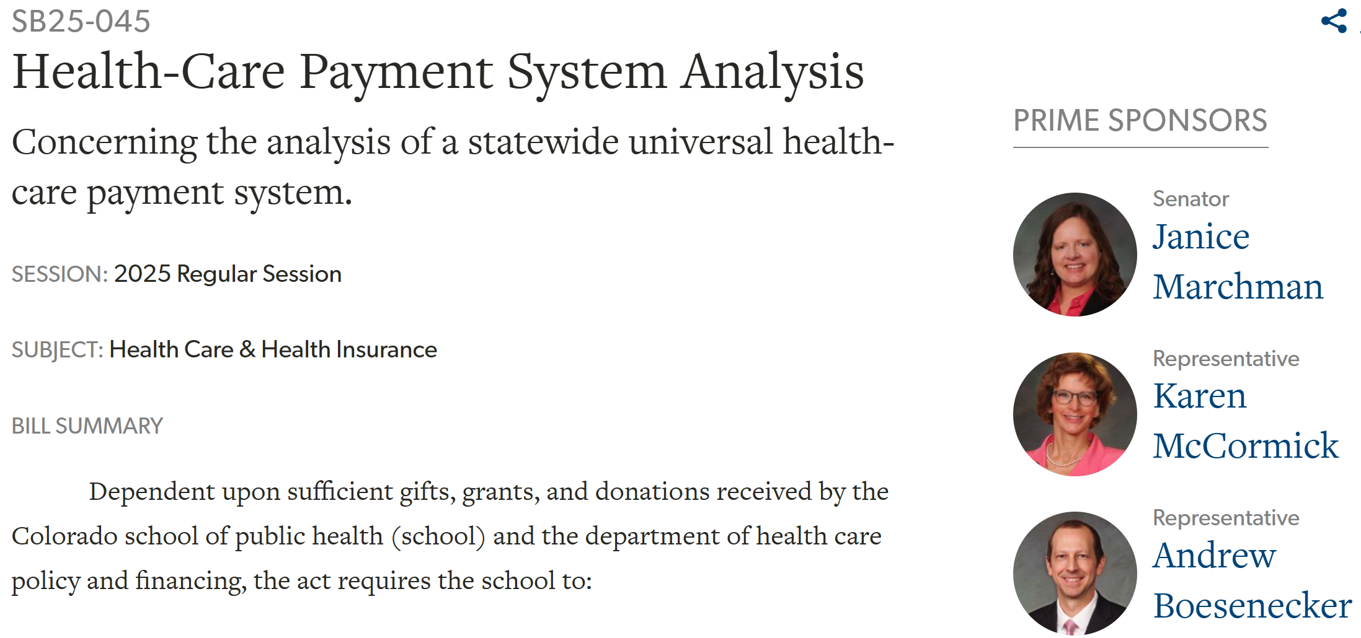
https://leg.colorado.gov/bills/sb25-045

Slide 3
Overview
HPSA will study the implementation and impact of a statewide universal health-care payment system for Colorado, including the system’s overall costs, financing mechanisms, payment policies, and its impact on patients, healthcare providers, employers, rural communities, the statewide economy, and the public’s health.

Slide 4
Research Team
Cathy Bradley, PhD, Dean and Professor, Colorado School of Public Health; Deputy Director, CU Cancer Center
Glen Mays, PhD, MPH, Judson Distinguished Professor of Health Policy; Chair of Health Systems, Management & Policy (HSMP)
Greg Tung, PhD, MPH, Associate Professor of HSMP
Beth McManus, PhD, MPH, Professor of HSMP
Travis Leiker, MPA, Assistant Dean of External Relations & Special Initiatives

Slide 5
Key Elements of the System
Single-payer, nonprofit, publicly financed, and privately delivered universal healthcare payment system.
Comprehensive benefits for medical care, dental, hearing, vision, behavioral/mental health, pharmaceuticals, women’s health,
long-term care
Patients choose among all participating providers
Funded by premiums based on household ability to pay
Prohibits deductibles and copayments
Fair payments for services that attract and retain providers
Examine global budgeting and alternative payment methods

Slide 6

Draft Model Legislation
Pursuant to Senate Bill 25-045, the Colorado Foundation for Universal Health Care drafted the model legislation for implementing a single-payer payment system for Colorado., with input from a broad coalition of stakeholders The HPSA study will analyze this model legislation and compare it with alternative options for achieving universal healthcare.
https://coloradosph.cuanschutz.edu/education/departments/
health-systems-management-policy/research/chcpa

Slide 7
Key Elements of the Analysis
Estimate 1st year, 2nd year, 5th year, and 10th year costs
Identify healthcare expenditures by source: federal, state, local, employer, household
Estimate impact on rural communities, racial/ethnic subgroups, and socioeconomic subgroups
Estimate impact on healthcare facilities, healthcare workforce, insurance industry, pharmaceutical prices, treatment for rare diseases
Estimate impact on the overall economy and overall health status
Compare with alternative models to achieve universal healthcare, including expanding the Colorado Option

Slide 8
Statewide Healthcare Analysis Collaborative
Senate Bill 25-045 authorizes an advisory body, the Statewide Healthcare Analysis Collaborative, to advise the school in conducting the HPSA study. Members will be appointed and convened by the Colorado Department of Health Care Policy & Financing (HCPF)

Slide 9
Timeline
July 1, 2025 – Publish model legislation
August 1, 2025 – HCPF invites members to serve on
Healthcare Analysis Collaborative
Thru October 1, 2026 – Collaborative meets to advise study
December 31, 2026 – ColoradoSPH submits report of findings

Slide 10
Leveraging Big Data
Colorado All Payer Claims Data System: statewide Medicare, Medicaid, and private health insurance claims
Colorado Hospital Discharge Data System: hospital and ED use including for uninsured patients
American Community Survey: sociodemographic characteristics of insured & uninsured
Colorado Behavioral Risk Surveillance System: self-reported health status, preventive service use, usual source of care
Medical Expenditure Panel Survey: deductible and cost-sharing
Health and Retirement Survey: long-term care use & spending

Slide 11
Analytic approach: microsimulation
Base model: Detailed records for each Colorado resident in the base year 2024 containing demographic information, insurance coverage, service use, expenditures, diagnoses, and health status
Research parameters: Extract estimates from scientifically reliable studies quantifying how service use, expenditures, and outcomes change in response to changes in insurance coverage and general temporal trends
Simulation: Apply parameters to base model. Estimate how each Colorado resident responds (1) under current policy* and (2) when moved to single-payer system: service use, expenditures, outcomes over time (10 years)
*including effects of H.R. 1 Budget Reconciliation Act of 2015

Slide 12
Analytic approach: microsimulation
Sector modules: Estimate how changes in service use and expenditures impact specific sectors: physicians, hospitals, employers, insurance industry, Taft-Hartley plans, pharmaceutical industry
Subgroup analysis: Detailed estimates for key subgroups of interest: rural communities, racial & ethnic minority populations, socioeconomic status
Comparison to alternative systems: Compare single-payer system to alternative systems that achieve universal coverage
(e.g. expansion of Colorado Option)
Sensitivity analysis: Examine sensitivity of results to alternative assumptions about parameter values

Slide 13
Estimating effects of current policy
H.R. 1 Budget Reconciliation Passed by Congress in 2025: Important consequences for estimating costs and outcomes under current policy
Medicaid work requirements: As many as 300,000 Coloradans at risk of losing Medicaid coverage
Expiration of enhanced premium tax credits: For households who buy insurance on the ACA marketplace, premium increases of up to 80%, rising out of pocket costs, and 35,000 Coloradans at risk of losing private insurance coverage.
Center on Budget and Policy Priorities www.cbpp.org

Slide 14
Get Involved, Give Feedback, Track Progress
As the HPSA study gets underway, the study website will share research plans, progress reports, and opportunities for the public to provide input, ideas and feedback. https://coloradosph.cuanschutz.edu/education/departments/
health-systems-management-policy/research/chcpa
For more information about this project and how to support
financially, please contact Travis Leiker,
Travis.Leiker@cuanschutz.edu
or call 303.817.5744.

