Slide 1
Thirteenth Meeting of the HB 21-1317 Scientific Review Council December 18, 2023

Slide 2
Opening Remarks, Introductions and Welcome; Updates on Conflict of Interest Christopher E. Urbina, MD, MPH Chair, HB 21-1317 Scientific Review Council

Slide 3
Scientific Review Council Members
Member | Role on Council | Affiliation(s)
Chris Urbina, MD, MPH (Chair) | Preventive medicine specialist (or preventive medicine public health professional) | Pueblo Department of Public Health and Environment; Former Director of CDPHE
Gregory Kinney, PhD, MPH | Epidemiologist | Colorado School of Public Health
Kelly Knupp, MD | Physician familiar with the administration of medical marijuana pursuant to current state laws to those aged zero to seventeen | University of Colorado School of Medicine
Kennon Heard, MD | Medical Toxicologist | University of Colorado School of Medicine
Archana Shrestha, MD | Neurologist | University of Colorado School of Medicine
Erica Wymore, MD, MPH | Pediatrician | University of Colorado, School of Medicine
Paula Riggs, MD | Psychiatrist | University of Colorado, School of Medicine
Susan Calcaterra, MD, MPH | Internal medicine physician (or other specialist in adult medicine) | University of Colorado School of Medicine
Joseph Schacht, PhD | Licensed Substance Abuse Disorder Specialist | University of Colorado School of Medicine
Kent Hutchison, PhD | Neuropsychopharmacologist | University of Colorado School of Medicine
Lesley Brooks, MD | Medical professional (or public health professional) who specializes in racial and health disparities and systemic inequalities in health care and medicine | North Colorado Health Alliance; SummitStone Health Partners

Slide 4
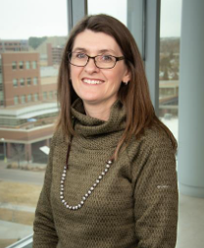
Dr. Kelly Knupp Joins the SRC
Dr. Knupp takes over for Dr. David Brumbaugh as the physician familiar with the administration of medical marijuana pursuant to current state laws to those aged zero to seventeen.
Dr. Knupp specializes in Pediatric Neurology at Children's Hospital Colorado and is an Associate Professor in the School of Medicine.

Slide 5
Cannabis Research & Policy Project Team Members
Member | Sub-Team
Charlene Barrientos Ortiz | Education Campaign
Lisa Bero, PhD | Systematic Review
Ashley Brooks-Russell, PhD, MPH | Subject Area Expertise
Paige Buchanan-Hall, BA | Education Campaign
Sheana Bull, PhD, MPH | Education Campaign
Meghan Buran, MPH | Administration
Annie Collier, PhD | Education Campaign
Colleen Keenan, MPH | Education Campaign
Jenn Leiferman, PhD | Education Campaign
Louis Leslie, BA | Systematic Review
Tianjing Li, MD, PhD, MHS | Systematic Review
Jean-Pierre Oberste, BA | Systematic Review
Christi Piper, MLIS | Systematic Review
Thanitsara Rittiphairoj, MD, MPH | Systematic Review
Jonathan Samet, MD, MS | Administration
Neeloofar Soleimanpour, MPH | Administration
Greg Tung, PhD, MPH | Administration, Subject Area Expertise
Sam Wang, MD | Subject Area Expertise
Tsz Wing Yim, MPH | Systematic Review

Slide 6
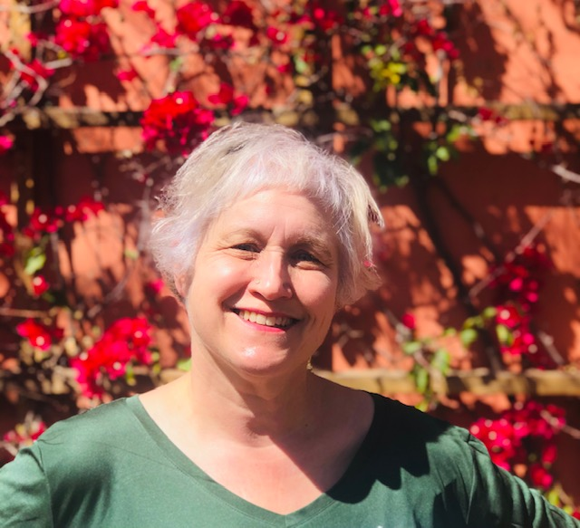
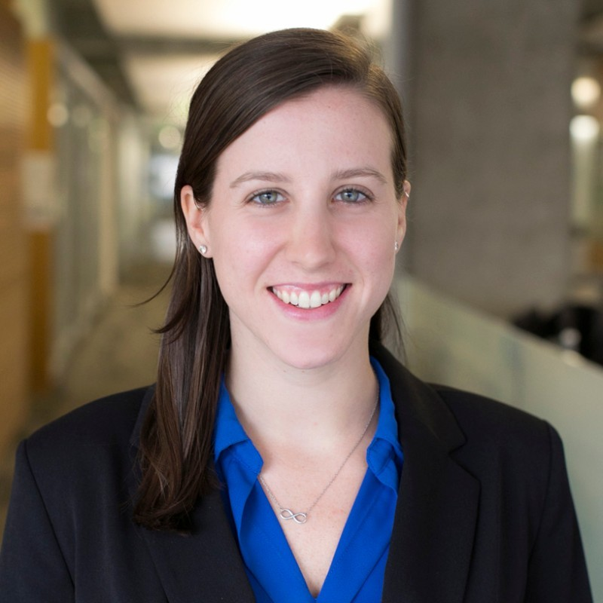
Dr. Annie Collier and Colleen Keenan Join the Communications Team
Dr. Annie Collier will be leading the Communications Team projects going forward. Dr. Collier is an Associate Professor in the Department of Community and Behavioral Health at Colorado SPH.
Colleen Keenan has joined the Communications Team as Project Manager.

Slide 7
Review of Agenda Christopher E. Urbina, MD, MPH Chair, HB 21-1317 Scientific Review Council

Slide 8
Scientific Review Council Meeting Agenda
9:00 AM | Opening Remarks, Introductions and Welcome, Updates on Conflict of Interest | Chris Urbina
9:10 AM | II. Review of Agenda and Meeting Minutes (7/25/23) | Chris Urbina
9:15 AM | III. Overview of Cannabis Research & Policy Team’s Progress Since Submission of Report | Jon Samet
9:25 AM | IV. Overview of Reviews in Progress | Tianjing Li & Jean-Pierre Oberste
9:40 AM | V. CME Meeting for Healthcare Providers | Sam Wang
9:45 AM | VI. Research Methods Workshop | Jon Samet & Lisa Bero
9:55 AM | VII. Terminology Discussion | Jon Samet & Chris Urbina
10:00 AM | VIII. Educational Campaign Update | Annie Collier
10:30 AM | IX. Open Discussion | Chris Urbina
10:55 AM | X. Next Steps & Closing Remarks | Jon Samet & Chris Urbina

Slide 9
Objectives of Today's Meeting
Update on overall progress from Cannabis Research & Policy Team
Discuss progress with the educational campaign
Next steps

Slide 10
Review of Meeting Minutes Christopher E. Urbina, MD, MPH Chair, HB 21-1317 Scientific Review Council

Slide 12
Overview of Progress by Cannabis Research & Policy Team Jonathan Samet, MD, MS Dean, Colorado School of Public Health

Slide 13
Overall Progress
Final report on scoping review submitted to the legislature in April 2023.
Since then,
Publications
Published manuscript by the American Journal of Public Health on the review
Submitted manuscript to Epidemiologic Reviews and brief to American Journal of Public Health on methodological challenges
In Progress
Mass-Media Behavioral Interventions
Modern Modalities in Behavioral Interventions
Mental Health Review
Respiratory Review
Policy Translation
Funding Bias
Educational Campaign
Presentation at Cannabis Research Conference, August 3
Planning Methods Workshop & CME Conference

Slide 14
Reviews in Progress Tianjing Li, PhD Associate Professor, Colorado School of Public Health Jean-Pierre Oberste, BA PRA, Colorado School of Public Health Tsz Wing (Valerie) Yim, MPH PRA, Colorado School of Public Health

Slide 15
Reviews in Progress
Updated Scoping Review
High-Concentration Cannabis Products and Mental Health Outcomes
Mass-Media Behavioral Interventions
Modern Modalities in Behavioral Interventions

Slide 16
Updated Scoping Review

Slide 17
Mental Health Review

Slide 18
Modern Modalities Review

Slide 19
Mass Media Behavioral Interventions Review

Slide 20
CME Meeting for Healthcare Providers Sam Wang, MD Associate Professor of Pediatrics CU School of Medicine

Slide 21
Continuing Medical Education Meeting
Planning Committee: Sam Wang, Jonathan Samet, R. Holbrook Stapp, Erica Wymore
Topics to be discussed:
Background of cannabis pharmacology, current marketing landscape, risk communication, evidence on health impacts of high concentration cannabis
April 24, 2024 at Children's Hospital Colorado, Anschutz campus
Basis for development of educational materials

Slide 22
Research Methods Workshop Jonathan Samet, MD, MS Professor, Colorado School of Public Health Lisa Bero, PhD Chief Scientist, Center for Bioethics and Humanities Professor of Medicine and Public Health

Slide 23
Advancing Methods in Cannabis Research
Planning committee: invitations pending
A recent scoping review of research on the health effects of high-concentration cannabis products (REF) revealed a number of methodological limitations. Importantly, there is a mismatch between the types and use patterns studied in the research and cannabis products as they are commonly used today. In addition, the review identified challenges associated with measurement of exposures and outcomes, confounding, and selection bias.
(We) are hosting a meeting to advance methods in cannabis research. The aim of the meeting is to develop recommendations to improve the standardization, generalizability and methodological rigor of the science.
Spring 2024

Slide 24
Terminology Discussion Jonathan Samet, MD, MS Professor, Colorado School of Public Health

Slide 25
Educational Campaign Update Education and Health Promotion for High-Potency Cannabis Report to the Scientific Review Council Ann Collier, PhD Associate Professor, Colorado School of Public Health

Slide 26
Agenda
Recap of Community Engagement Workshops & Recommendations
Overview of Educational Campaign Components
Educational Toolkits
Materials Creation
Art Exhibition
Overview of Campaign Timelines
Overview of Evaluation
Continued Community Engagement Efforts

Slide 27
Phase 1(Completed) Community engagement approach
Community Engagement Workshops
Workshop Participants
1
Introduction to HB 1317 & Scientific Review Process
Youth (aged 16 -23) and adult advisors
African American, Latino, White
Male, female
LGBTQIA+
2
“What Works” in Health Promotion Campaigns
3
Recommendations for HB 1317 Educational Campaign
Denver, San Luis Valley, Pueblo
Notes:
How many participants? How were they selected?

Slide 28
PHASE 1 (Completed) Community Advisor Recommendations
Key Messages
Focus on youth mental health and self-actualization
Cannabis – and other substances – do not serve to achieve these goals
Cannabis should not be misconstrued as safe for the developing brain
How to Share Key Messages
Utilizing Educational Toolkits
Peer mentoring
Community events
Community-based “pop-ups”
Training in MI for parents/trusted adults
Train-the-trainer model
Social media channels and influencers
Notes:
Peer mentoring with middle schoolers in school settings for goal setting, self-actualization and coping strategies. Build specific refusal skills.
Link with community events to embed the program in communities
Create “Pop-ups” in communities specifically focused on cannabis education
Use social media to amplify in-person programs and offer additional tips and strategies
Toolkits for adults to talk to their kids and for trusted adults to talk to other youth
Train the trainer model; trusted leaders who work with kids teach other adults how to use the resources to talk to others
Use Social Media influencers to teach other adults online

Slide 29
Phases 2, 3 and 4: Educational campaign
Phase 2: Content Creation
Toolkit Creation
Phase 3: Product Creation
Materials Creation
Art Exhibition
Phase 4: Content Dissemination
Community Events
Training & Education Events
Social Media & Advertising
Art Exhibition
Community Engagement
Community Engagement
Notes:
Educational campaign directives came from community engagement
Toolkits
Materials Creation – videos, written materials (e.g., infographics, blogs, flyers), instructional design course, swag)
Art Exhibition
Community Events
Training & Education Events (this could include the CME conference Jon/Sam are planning)
Social Media & Advertising
Community Engagement Throughout

Slide 30
Educational & Skills Building Toolkits
1. Raising Awareness of HCC¹ and its Impacts on Health
3. Cannabis Use During Pregnancy
Definition & background of high concentration cannabis
Physical/mental health impacts for:
Youth
Pregnant people
Factors that influence stress management, coping strategies, and vulnerability to substance use during pregnancy
Support healthy behaviors as an alternative to cannabis to manage stress and build supportive coping strategies
2. Youth Cannabis Use
4. *Motivational Interviewing Tools
Factors that influence youth stress management, coping strategies, and vulnerability to substance use
Support healthy behaviors as an alternative to cannabis to manage stress and build supportive coping strategies
Strategies to assess readiness for behavior change and to facilitate behavior change itself
Scenarios to support conversations around cannabis use behaviors
*Audience: providers, parents, and other adults that interact with youth and pregnant people
1. High concentration cannabis.
Notes:
*Note that toolkits will not be public facing. They serve the purpose of providing vendors with accurate information to create various content materials.
Using the toolkits as a hub for future content creation and supporting community events
Content from toolkit came through community engagement suggestions
There may be additional toolkits in the future, based on needs and interests → for example, additional modules could include how to disseminate public health information via pop-ups and social media

Slide 31
Materials Creation
Vendor Selection
Vendors apply to create campaign materials based on educational toolkits
Vendor selection committee will identify and hire the most appropriate companies and individuals to work with
*Content Creation
Vendors will create educational videos, written materials, web-based curricula
Content Dissemination
Educational campaign team will distribute the materials through diverse channels to effectively reach the target populations
Channels include: science-informed art exhibition, community events (e.g., block parties), training events, social media, and other advertising outlets
Instructional design vendor(s) will generate course shells to support training activities
Marketing materials such as a brand, logo, and tagline will facilitate dissemination
WHEN: application deadline 12/31; vendor selection early January 2024
WHEN: January through April 2024
WHEN: May through June 2024
Community Engagement
Community members will:
Sit on and participate in the vendor selection committee
Create content with vendors
Provide input on the art exhibition
Facilitate and support training and community events
* Educational campaign team will seek SRC approval before finalizing vendor content

Slide 32
Dissemination: 2024 HCC Science-informed art exhibition
Benefits of Science-Informed Art
Provides a unique medium to share messages and engage target audiences
Addresses issues through a lens of social justice and humanity
Artists educated on topics then become long-term ambassadors for key messages
Promotes dialogue by projecting emotion and complexity into a visual narrative to help viewers understand more than just numbers and findings
Generates excitement and debate through creative and compelling artwork
Attracts and generates media attention across diverse outlets
Notes:
Interest in art exhibition came through community engagement, especially with youth.

Slide 33
Art Exhibition Key steps
Art Exhibition Milestones
Artist Application
Artist Educational Forum
Denver Exhibition
WHEN:
December 31, 2023
WHEN:
February 8-10, 2024
WHEN:
June 2024
WHAT:
Deadline for artists to apply to be considered for participation in the exhibition and project
WHAT:
2-day educational workshop on the topic of HCC
WHAT:
Opening reception, exhibition event, artist talks, and other public events
Educational campaign team will seek SRC input on the training content
Exhibition will likely remain open beyond June
Notes:
If there is a positive community response and it is funded in the future, additional sites, artists, and community members will become involved.
Potential Concerns:
Artists will likely reflect the uncertain nature of the scientific findings
Some artists may choose to highlight the benefits or harms of HCC use
Controversy and debate may arise in response to the exhibition, all likely to promote discussions
Special interest groups may oppose the exhibition and/or toolkit
Critics may question why the project doesn’t tackle higher-risk drugs
The unknown: we cannot predict every debate or challenge that arises
Each concern, however, raises the likelihood of public debate, awareness, and media coverage that will help to promote the scientific findings of the toolkit

Slide 34
Art Exhibition: Artist educational forum
School of Public Health faculty will present the scientific findings about HCC across a 2-day workshop
Education will parallel toolkit, and focus on the effects of HCC on the physical and mental health of youth and pregnant people
Community members will also share their perspective & stories on the topic
Artists will reflect & share with each other to begin their creative journey
Notes:
After the workshop, artists will have three months to create new artwork on the subject matter. The exhibition’s curators will monitor the artists’ progress to ensure thematic resonance and to avoid duplication.
Artists will have creative freedom to address the topic from the perspective of their choosing.
We will ensure that community members participating in the educational forum do not have a conflict of interest
Re-iterate that SRC will have input on the training content

Slide 35
Art Exhibition: Associated deliverables
Professional artists will create artwork, after training in HCC issues/evidence
Youth engagement artwork project (possible secondary art exhibition)
Artist/curator public lectures, performances, spoken word presentations that parallel the exhibition, to promote further dialogue
CSPH team will create display panels which convey scientific context from the toolkit; available during exhibition and for display afterwards at community events
Published catalog of artwork photographs and scientific findings will be available during exhibition and afterwards
1
2
3
4
5
Notes:
Art exhibition and series of public events where artists present creative and innovative perspectives based on the scientific findings of the public health team.

Slide 36
Campaign timelines
Notes:
Phase 2: Content Creation
Phase 3: Product Creation
Phase 4: Content Dissemination

Slide 37
Campaign Program Evaluation
Primary Goal
Secondary Goals
Tertiary Goal
Assess the campaign’s impact on knowledge, attitudes, beliefs, and intentions to use or avoid HCC, as well as possible longer-term changes in health behaviors
Raise awareness about HCC and its impact on health
Increase skills in effective communication about HCC use
Promote dialogue around the impacts of recreational HCC products
Support healthy behaviors as an alternative to cannabis consumption which could lead to long-term behavior change
Assess vendor and community member satisfaction with involvement in the process

Slide 38
Evaluation Logic Model
Outputs
Inputs
Outcomes
Activities
Participation
Implementation
Outcomes
-Staff
-Toolkits
-Modules
-Content (videos, courses, etc.)
-Scientific review council
-Assess
knowledge, attitudes,
norms, and
intentions
-Art exhibition
-No. of artists, art
pieces, vendors,
participants
-Artists, patrons
-Parents, peers, supporters, providers of youth/pregnant people
-No. of trained
individuals
-Training
-Community
events
-Community
members
-No. of events and
materials distr.
-Social media
-Online users
and influencers
-No. of views, likes,
and impressions
-Other
advertising
-General public
-No. of ads and
penetration data
Notes:
Annie – mention that we have the potential to assess behavior change longitudinally if the project continues

Slide 39
Ongoing Community Engagement
Provide input on toolkits
Selection of vendors
Creation of content with vendors
Support training & community events
Provide input on art exhibition
Contribute to evaluation
Community Engagement
Notes:
Community input is essential at every stage of the process to ensure the effective reach and impact of our messages to the populations of interest.

Slide 40
SRC Discussion Christopher E. Urbina, MD, MPH Chair, HB 21-1317 Scientific Review Council

Slide 41
Next Steps & Closing Remarks Jonathan Samet, MD, MS Dean, Colorado School of Public Health Christopher E. Urbina, MD, MPH Chair, HB 21-1317 Scientific Review Council

