Slide 1
Improving Cochrane evidence: lessons from public health reviews
Lisa Bero, Ph.D.
Research Integrity and Public Health Senior Editor
University of Colorado receives remuneration for this work

Slide 2
Our Mission
is to promote evidence-informed health decision-making…
…by producing high-quality, relevant, accessible systematic reviews and other synthesized research evidence.

Slide 3
The Cochrane Library
Review development, editorial process, and publishing

Slide 4
Cochrane Reviews are of higher quality
Page MJ et al. Epidemiology and Reporting Characteristics of Systematic Reviews of Biomedical Research: A Cross-Sectional Study. PLOS, May 2016 (http://dx.doi.org/10.1371/journal.pmed.1002028)

Slide 5
International standards for synthesized evidence …

Slide 6
It’s working … increasing quality & complexity
Sustained increases in Impact Factor for the Cochrane Database of Systematic Reviews (CDSR) – 5.6 to 7.9 from 2009 to 2019.
3rd highest cited medical journal – 67,736 citations in 2019.
CDSR ranked 10th out of 165 journals in the Medicine, General & Internal category in 2019.
Increasing number of included studies in new Cochrane Reviews – 13.1 in 2016 to 18.8 in 2020.
Over 95% of all Reviews contained Summary of Findings Tables.

Slide 7
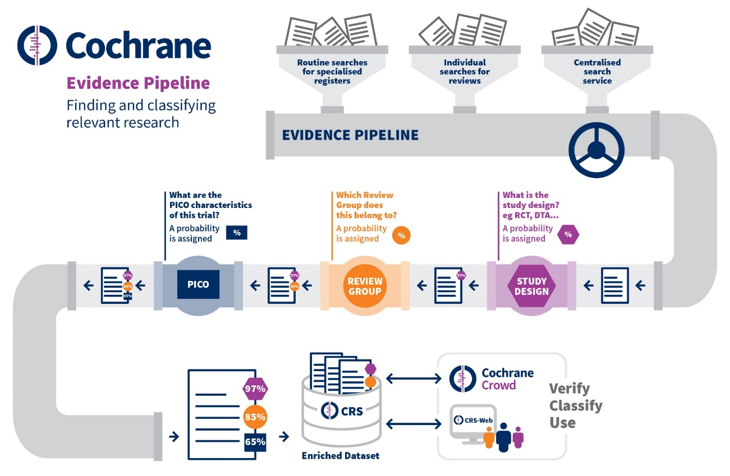
A seamless evidence pipeline
04
Surveillance of primary research to support efficient integration into Cochrane Reviews
Improves the author experience
Keep reviews updated
Notes:
Together these products provide a new tech system to support review production. This is a simplified view, also other tools such as EPPI-Reviewer, GradePro, etc.
We are now working on creating the linkages required to implement the new workflow, which will use all of these tools by default.
The next step is to roll-out this new, more efficient workflow for producing Cochrane Reviews that uses the new technology by default
Huge investment in technology – results are now visible – any will only become more apparent.
We need to ensure that as we move forward in the final years of Strategy to 2020 that we really bring together the people, process and technology to ensure we maximise return on all of this investment – technology alone will never solve problems.

Slide 8
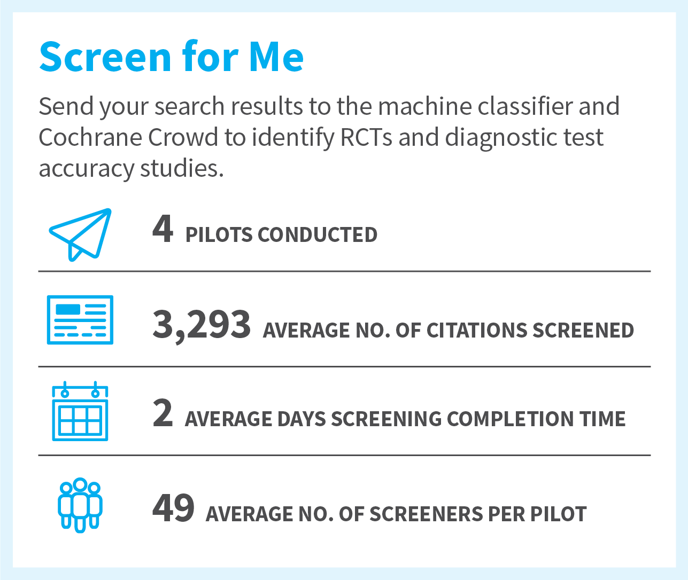
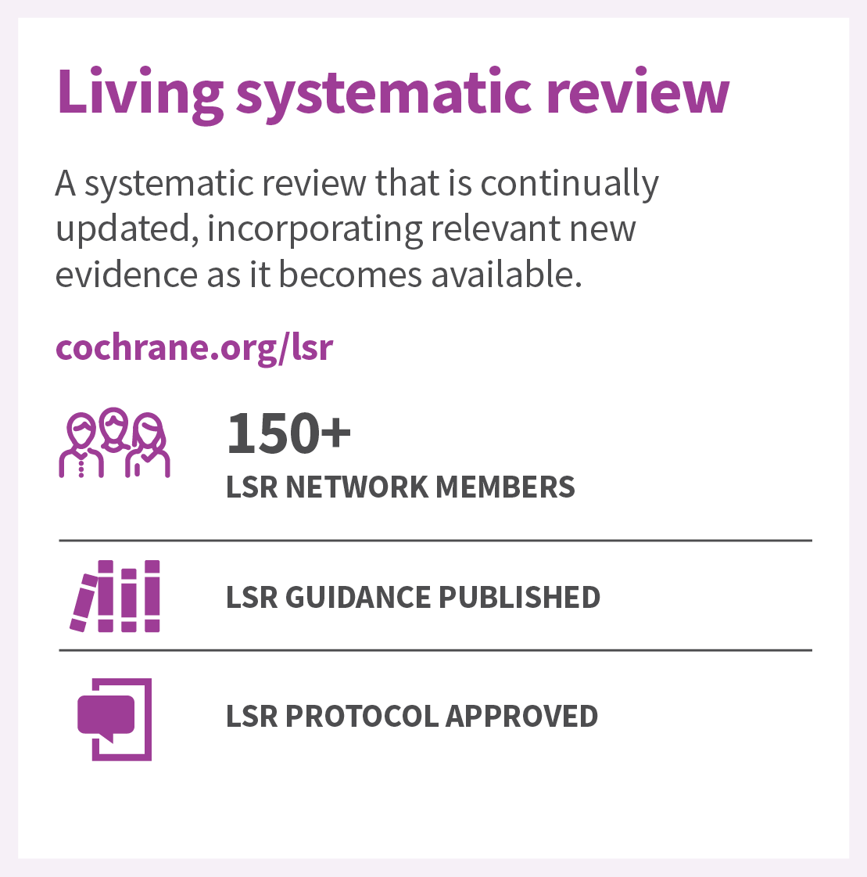
Efficient production and living evidence
04
6
270+
QUARANTINE RAPID REVIEW
6,000 CITATIONS SCREENED
48 HOURS COMPLETION TIME
9 REVIEWS AND PROTOCOLS PUBLISHED IN THE LIBRARY
123 CROWD CONTRIBUTORS
Notes:
Together these products provide a new tech system to support review production. This is a simplified view, also other tools such as EPPI-Reviewer, GradePro, etc.
We are now working on creating the linkages required to implement the new workflow, which will use all of these tools by default.
The next step is to roll-out this new, more efficient workflow for producing Cochrane Reviews that uses the new technology by default
Huge investment in technology – results are now visible – any will only become more apparent.
We need to ensure that as we move forward in the final years of Strategy to 2020 that we really bring together the people, process and technology to ensure we maximise return on all of this investment – technology alone will never solve problems.

Slide 9
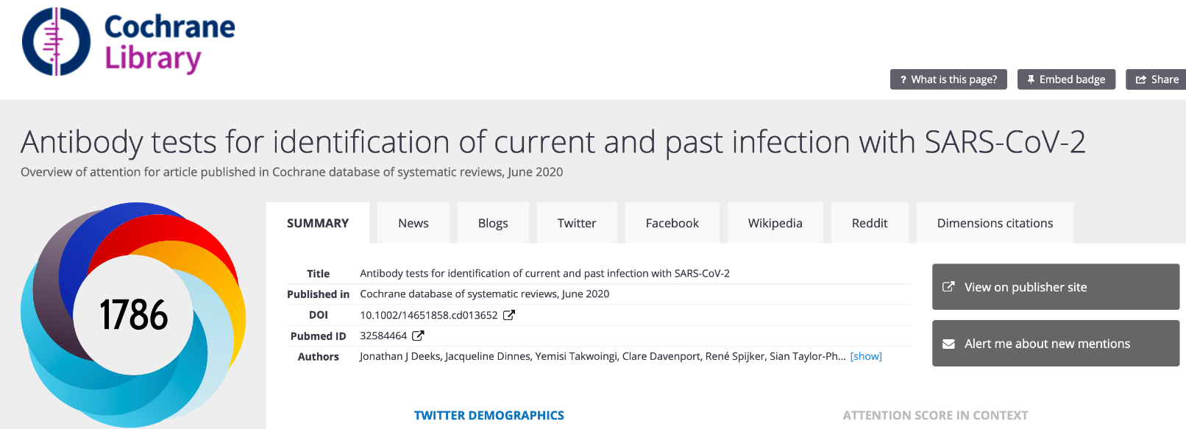
Trusted and timely evidence that responds to the need of end-users In the top 5% of all research outputs scored by Altmetric.
01
Notes:
Wikipedia - the altmetric report for our newest Living Systematic Review may be interesting.

Slide 10
Big data and multiple review formats complicate our life…

Slide 11
Notes:
The challenge of producing new high-quality content …

Slide 12
Key lessons learned from the response to the COVID-19 pandemic

Slide 13
Key learnings from the COVID-19 pandemic
September 2020
15 Rapid/Living Reviews published from April-September 2020
Moving from sprint to marathon:
Protocol development
Topic areas that require Living Systematic Reviews
Lessons learned
February 2020
COVID Working Group formed.
Rapid Response Cochrane site launched.
Work with partners on priority reviews.
April 2020
COLLABORATION!
Cochrane priorities for future Rapid Reviews and Living Systematic Reviews communicated.
Editorial workflows developed to triage submissions and fast-track priority reviews.
Notes:
Highlighted Cochrane’s ability to respond quickly to the needs of end-users of evidence
Underscored importance of working with policy makers, practitioners, patients and other key stakeholders in defining research priorities
Emphasized the importance of producing evidence quickly while maintaining high quality of reviews
A formal evaluation of Cochrane’s organizational response to COVID-19 is beginning now to incorporate learning into future planning

Slide 14
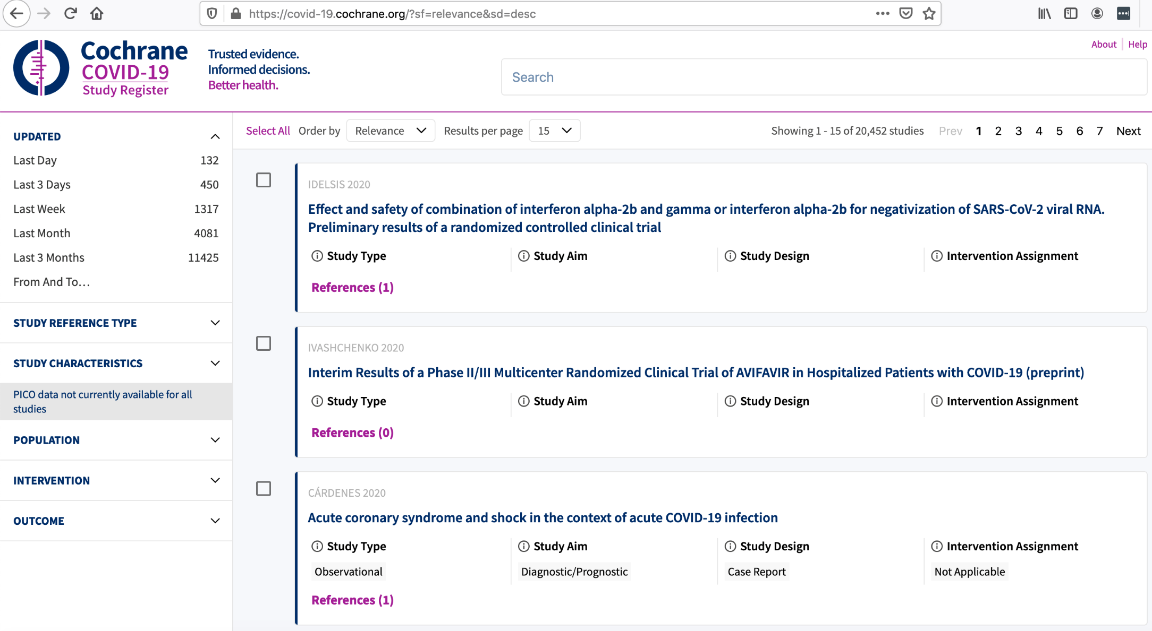
https://covid-19.cochrane.org

Slide 15
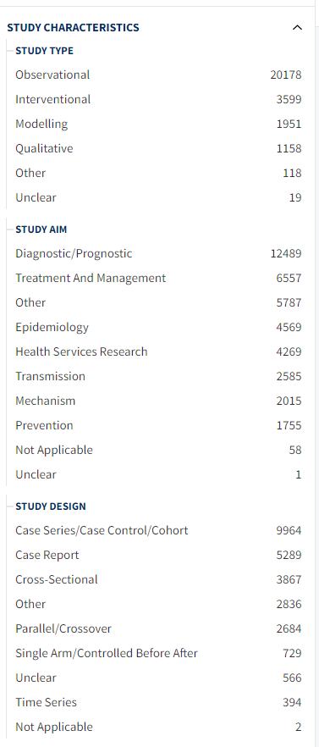
As of Oct 28, 2020

Slide 16
Cochrane published four rapid reviews of the evidence on different public health measures to slow the spread of COVID-19.

Slide 17
Exposures

Slide 18
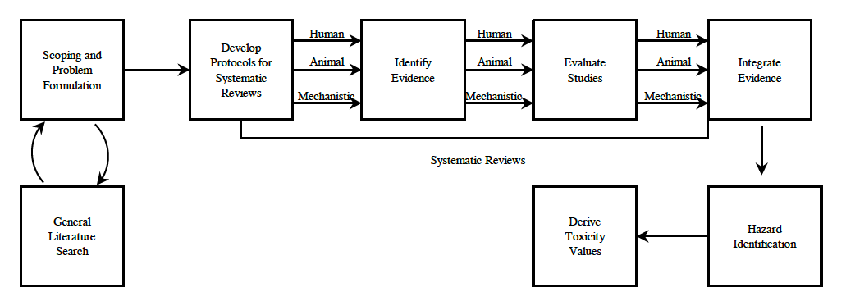
And… it’s not just COVID
“ …systematic-review standards provide an approach that would substantially strengthen the IRIS process…” NAS 2014

Slide 19
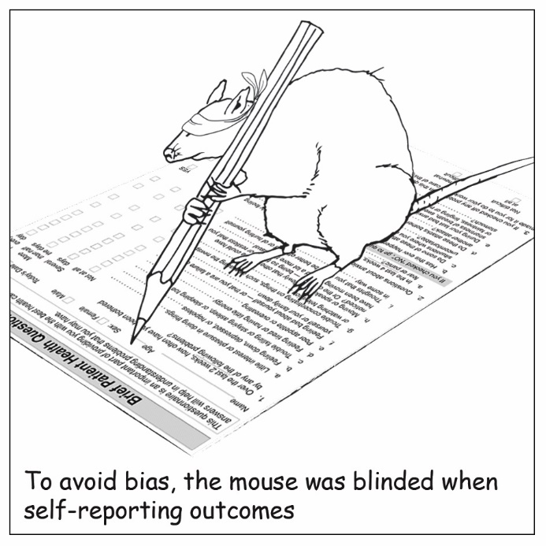

Slide 20
New tools every day
Advances in Nutrition

Slide 21
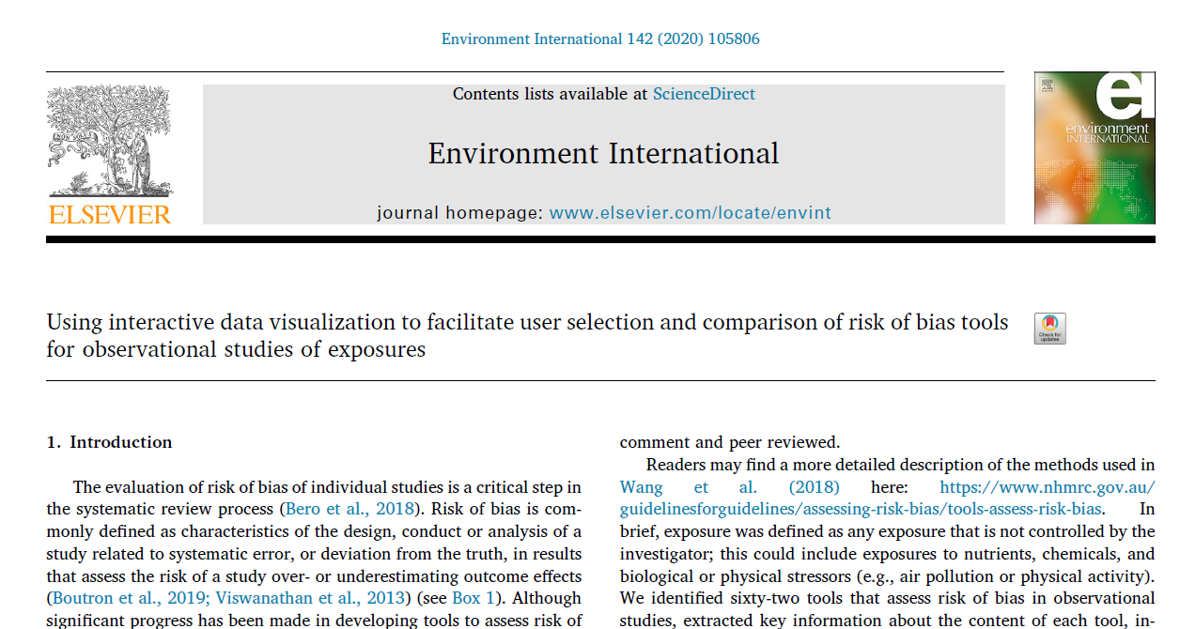
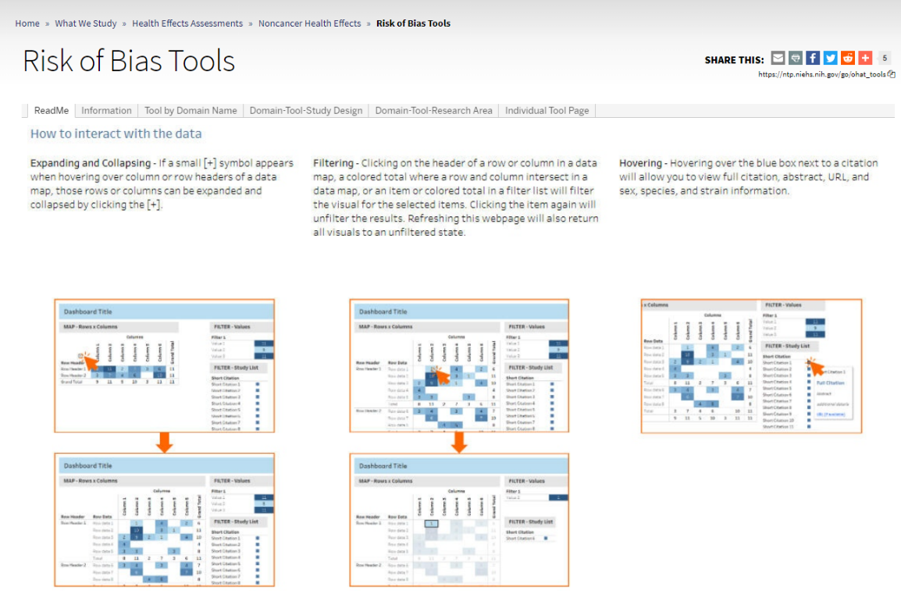
https://ntp.niehs.nih.gov/go/ohat_tools

Slide 22
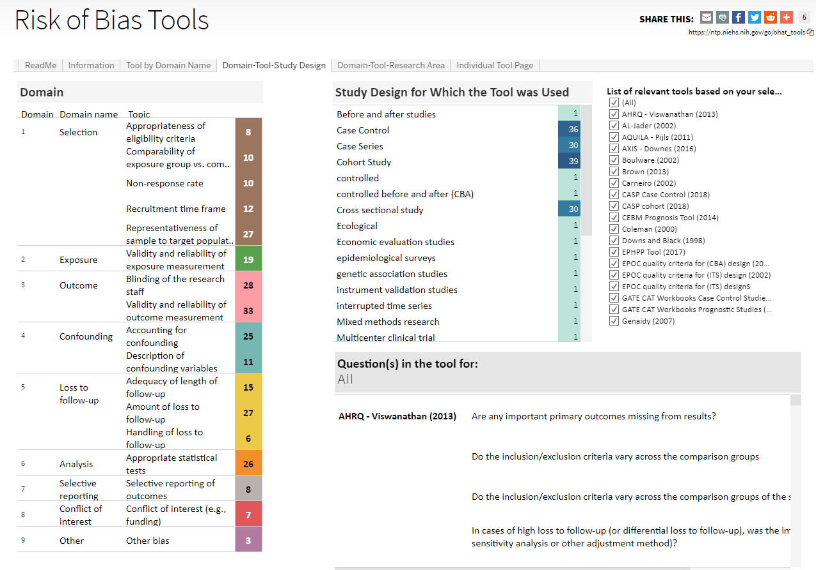

Slide 23
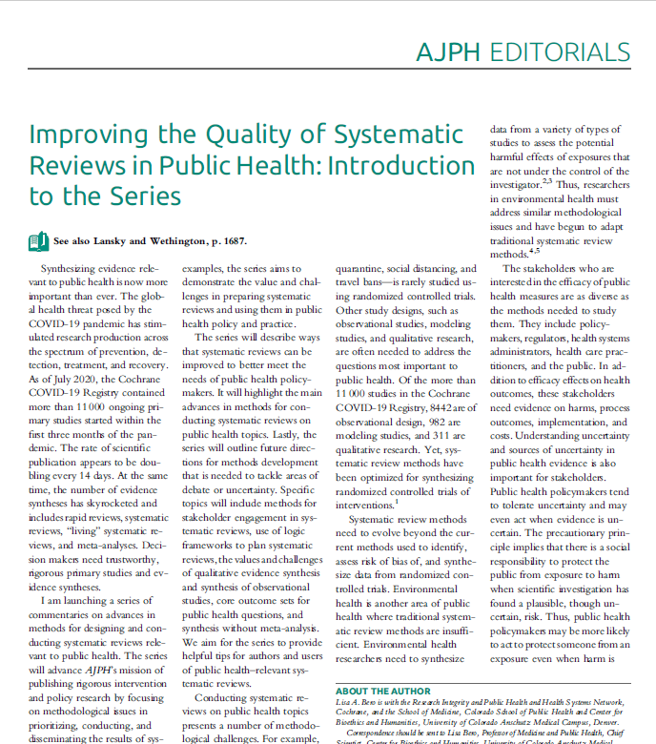

Slide 24
Topics for methods series
Framing questions
Using logic frameworks
Population vs individual risk
Stakeholder engagement
Core outcome sets
Qualitative evidence synthesis
Synthesis without meta-analysis

Slide 25
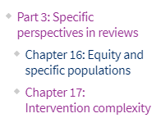
Intervention complexity
Intervention complexity
Number of components in the intervention
Interactions between components, with context, or both
Interventions within complex (adaptive) systems
Pettigrew 2019: “..many potential sources of complexity to be considered in both complex interventions and complex systems perspectives.”

Slide 26
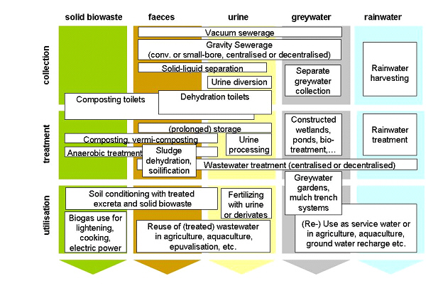
Drinking water, sanitation and hand hygiene (‘WASH’ interventions)
15 reviews across 6 review groups (1 Campbell) !
Project: To identify frameworks and logic models for classifying WASH interventions, taking complexity into account. Map current Cochrane reviews and protocols against the standard frameworks.
Notes:
Project spearheaded by Infectious Disease Group

Slide 27
Interested in the how and why
?
Notes:
In PH it is important to know not only whether an intervention works or not, but how it works, in what contexts, why. Important for implementation. Value of qualitative research. Examples.
Qualitative Evidence Synthesis which Safer
Care Victorian is involved in. This enables us to meet Cochrane’s current requirements
and not delay the person-centred review. Titles of the reviews, led by CHCP staff, are:
· Interventions for working in partnership at the health service level for the
promotion of person-centred care. Dianne Lowe, et al.
· Working in partnership at the health service level for the promotion of personcentred
care: a qualitative evidence synthesis. Bronwen Merner, et al.

Slide 28
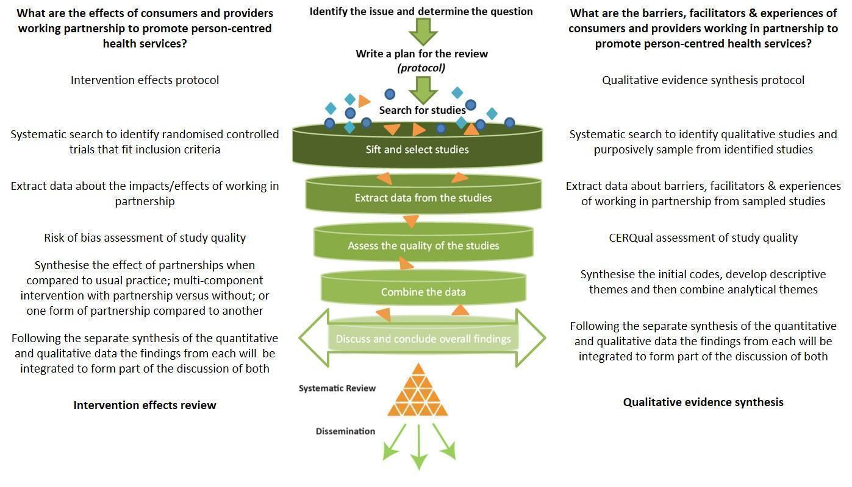
*Kaufman J. Infographics. cccrg.cochrane.org/Infographics. (accessed October 2019)
Lowe D, Merner B, Graham‐Wisener L, Walsh L, Hill S. The effects of consumers and health providers working in partnership as an intervention for the promotion of person‐centred health services. Cochrane Database of Systematic Reviews 2019, 7. Art. No.: CD013373. DOI: http://dx.doi.org/10.1002/14651858.CD013373
Notes:
Intervention: RCTs on impact, effects of working in partnership
Qualitative: barriers, facilitators, and experiences of working in partnership
At the time, the Cochrane policy wouldn’t allow for a standalone qualitative review to be conducted in isolation without a paired intervention review.
The stakeholders requested a qualitative evidence synthesis, but the only way to progress this, and adhere to Cochrane policy, was to also commence a corresponding intervention review.
The authors ultimately agreed to do this, but at significant additional effort and expense.
In effect, the Cochrane policy required that the authors complete two reviews to meet the stakeholders’ needs for one.
THIS HAS LED TO the PHHS network pilot project of stand alone QES

Slide 29
Data on harm
Notes:
Controlling for co-exposures that are not confounders can introduce bias towards finding no effect.. Due to overadjustment or exclusion of data

Slide 30
To evaluate the effects of water fluoridation (artificial or natural) on the prevention of dental caries & dental fluorosis
4 outcomes
Update the evidence on the health effects of water fluoridation from NHMRC’s 2007 review to assist NHMRC to provide evidence-based guidance on the potential benefits and harms of water fluoridation.
36 outcomes
Notes:
LB: COCHRANE REVIEW FAILS TO INCORPORATE NEWER EVIDENCE THAT ADDRESSES SLIGHTLY DIFFERENT BUT IMPORTANT POLICY QUESTION. Argues for a review no longer being updated, but rather a new question being asked. Cochrane would probably not cover all the outcomes of interest for this guideline, but could certainly cover some. Shift resources from old review to newer more policy relevant review – would require new protocol.

Slide 32
03
A focus on Research and Editorial integrity
Research integrity
Free of commercial conflict of interest
Advocating for trial transparency
Implementation of editorial policies
Training on editorial best practices
Editorial process integrity

Slide 33
Relevant comparisons
Drug vs drug vs drug vs drug, system vs system, drug vs non-drug………

