Slide 1
Functional data analysis with wearable device data
Julia Wrobel, PhD
Assistant Professor
Department of Biostatistics and Informatics

Slide 2
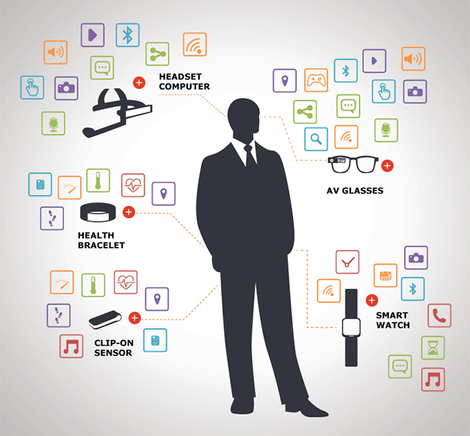
What do wearables offer?
Sleep
Circadian Rhythmicity
Light, Temperature (Circadian markers)
Blood Glucose Monitoring
Electronic diary/Ecological momentary
assessment (1-2-4 per day)
Heart Rate (ECG, BPM)
Physical activity
Activity Counts
Sedentary behavior
Steps and Gaits
Notes:
- Say gonna use PA as a case study, to show how some newer methods can leverage the rich ness of information collected continuously to better understanding both the timing and magnitudue of patterns in these data

Slide 3
Accelerometer data processing pipeline
PA measures: Total steps / counts, MVPA minutes,
Sedentary measures: Sedentary time, number of sedentary bouts
Notes:
Shown is raw accelerometry data at 80 Hz
Activity count at the minute level, can also get steps
Extract one-number summaries
What if we just skipped the last step? What is lost in this preprocessing?

Slide 4
Functional data analysis (FDA)
Wearable devices record signal over 24-hour periods- the exact focus of FDA!
Outcome is curve or function $Y_{i}\left(t\right)$
For accelerometer data each curve/outcome is a 24-hour activity profile
There are functional analogs of common data analysis tools
Functional regression, functional principal components analysis
Y
Notes:
Functional data perspective considers 24 hour trajectory Yi(t)
I focus on one day for each person
Gonna talk about framework for separating this periodicity from activity intensity

Slide 5
Uses for FDA in wearables
Less pre-processing of the raw data
Compare across different studies
Compare across devices, manufacturers, wear locations
Better ways of imputing data
Missing data is a big problem in wearables
Time-dependent interpretations, potentially across devices
Timing and consistency
Integrating all behaviors (jointly analyze PA, sleep, sedentary behavior)
Notes:
I’m going to focus on one time-dependent analysis in particular that we recently published
- In particular, timing of PA in the UK Biobank study

Slide 6
Goals of this analysis
Understand patterns of physical activity using functional data methods
Huge dataset (>80,000)- still computationally feasible?
Focused on age, gender differences in daily patterns of PA
Analyzed an “average” 24-hour day for each subject
Notes:
I’m going to focus on one time-dependent analysis in particular that we recently published

Slide 7
UK Biobank Accelerometry Data
88,793 subjects
39,255 men and 49,538 women
42-78 years of age (mean: 61.9 years of age)
Raw acceleration data was aggregated reproducibly
Euclidean norm minus one (ENMO) of raw tri-axial accelerometer data
Produces sub-second “activity count” that is open-source and reproducible
Averaged activity count at minute level for each subject
Produces 24-hour minute-by-minute trajectories or activity profiles
1440 minutes of observation for each subject

Slide 8
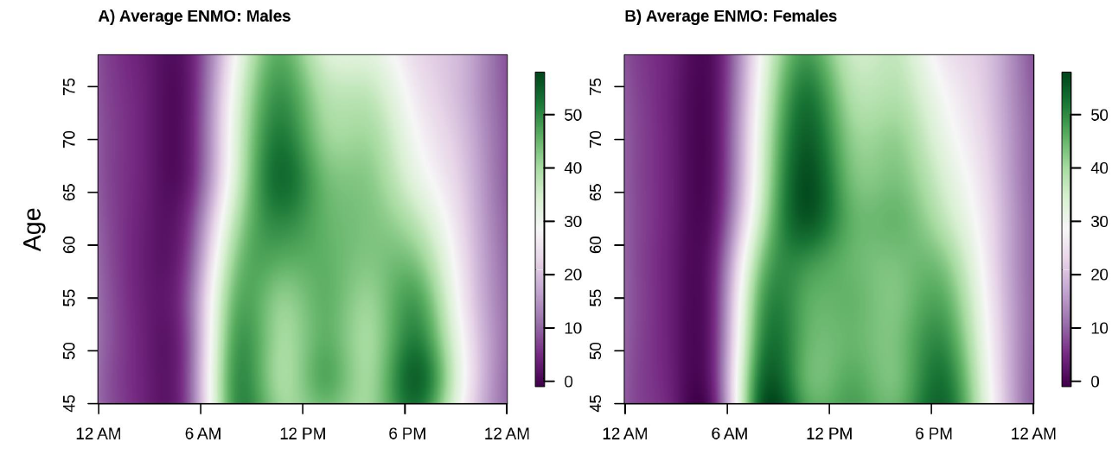
Diurnal patterns in physical activity across ages
Average activity intensity across ages for males (left) and females (right) from functional regression

Slide 9
UK Biobank Analysis Takeaways
PA decreases with age for males and females
This decrease occurs predominantly in afternoon/evening hours
Females have higher probability of being active, especially at older ages
Comes from FDA analysis of sedentary behavior in this data
Similar patterns are seen in BLSA, NHANES
Suggests social/behavioral patterns shared across populations

Slide 10
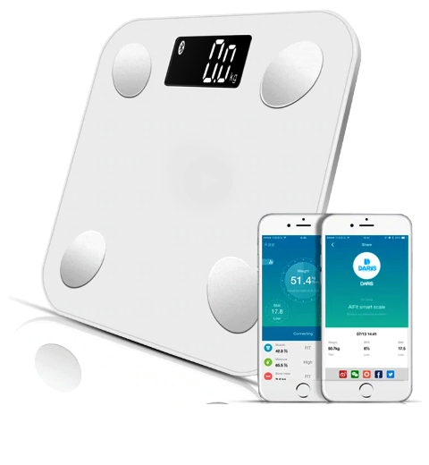
Other ongoing “wearables” and FDA projects
Using patterns of sedentary behavior to detect human chronotypes
Chronotypes are behavioral manifestations of circadian rhythms
Clustering daily weigh-in data
Bluetooth scales as “wearable” data
Are certain patterns in weigh-ins associated with
long-term weight maintenance?
Notes:
- Have a couple other ongoing projects using wearables and FDA

Slide 11
Thanks!
Contact Info
julia.wrobel@cuanschutz.edu
juliawrobel.com
github.com/julia-wrobel

Slide 12
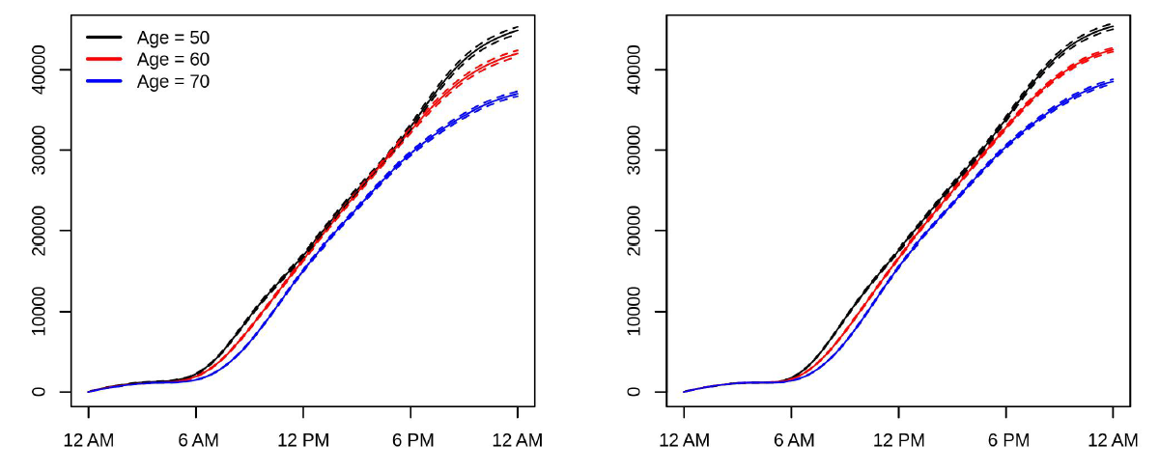
Activity drop off occurs mainly in evening hours
Average cumulative activity intensity for males (left) and females (right)
Notes:
- All the way up until 6 pm, same level of cumulative activity!
- 60 year olds catch up to 50 year olds in cumulative activity mid-day, but drop off again in the evening

Slide 13
Reproducibility and rigor …
A good deal of this isn’t settled
Consider MVPA
How are counts generated?
How are cutpoints found?
Are these consistent across devices? Age groups? Placements
Some general recommendations
Keep rawest form of data possible
Process using non-proprietary software
Follow a plan to ensure reproducibility
Notes:
These essentially amount to limitations of our current analyses

