Slide 1
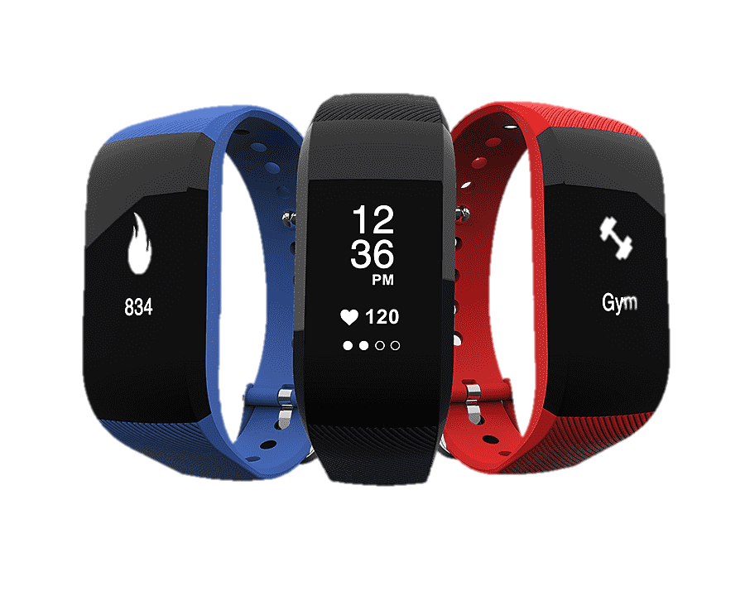
Using Wearables in Clinical Research
Seth A. Creasy, PhD
Assistant Professor
Department of Medicine

Slide 2
SLEEP

Slide 3
Measures of Sleep
Wearables use movement (accelerometry), light sensors, skin temperature, and heart rate to estimate parameters of sleep
Sleep Duration (h/day)
Sleep Timing (Bedtime, Waketime, Mid-point of Sleep)
Sleep Consistency/Regularity (Social Jetlag, SD of Bedtime/Waketime, Sleep Regularity Index)
Measures of Sleep Quality (Sleep Onset Latency, Wake After Sleep Onset, Number of Awakenings, Sleep Efficiency)

Slide 4
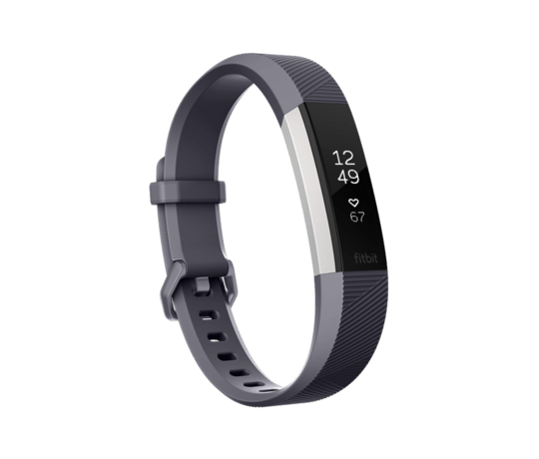
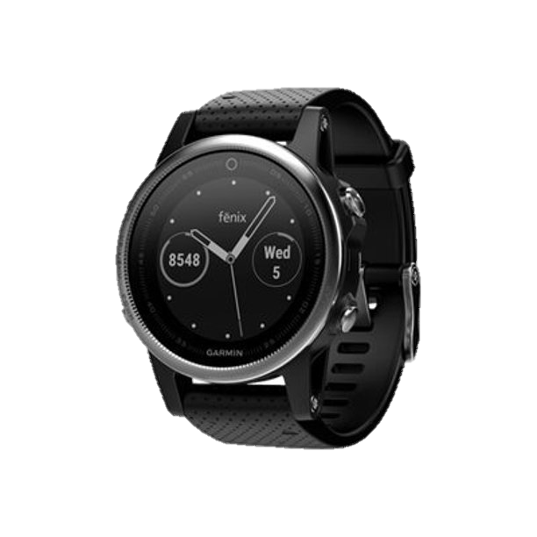
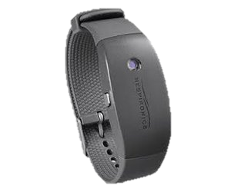
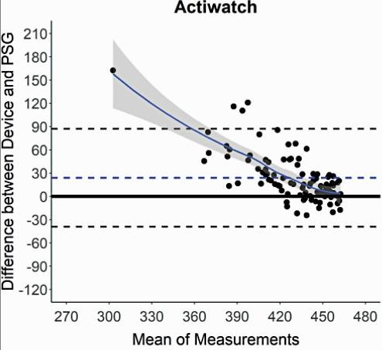
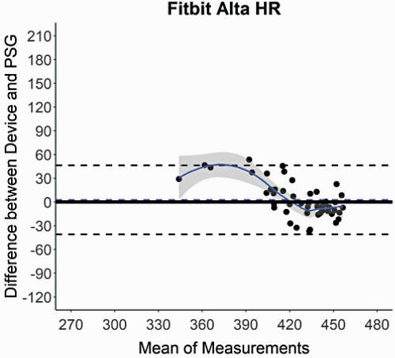
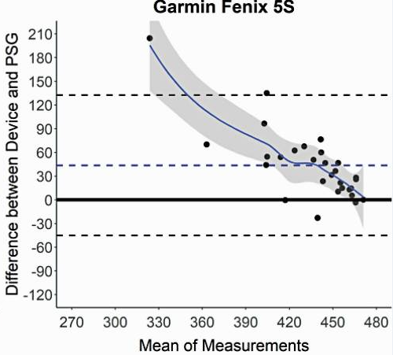
Accuracy of Sleep Duration Measurements
Bias: 23.9 min
Bias: 2.6 min
Bias: 43.7 min
Chinoy et al. SLEEP 2021.

Slide 5
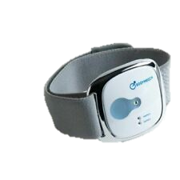
Clinical Implications
CU-Anschutz Shoutout
Laura Grau, MPH
Grau et al. Sleep Science In Press.
↑ Sleep Efficiency and ↓ SOL = ↑ Weight Loss
↑ Sleep duration, ↑ SOL, ↑ WASO, Later Waketimes = ↓ Odds of meeting recommended amounts of MVPA
No association between indices of sleep and odds of meeting dietary recommendations

Slide 6
Future Directions
Continue improving measurements of sleep quality (SOL, WASO, awakenings, sleep staging) and improve detection of motionless wake
Need for multiple inputs/sensors to help improve these measures
New populations
More use in clinical research

Slide 7
SEDENTARY BEHAVIOR

Slide 8
Measures of Sedentary Behavior
Wearables use posture and/or movement estimate sedentary behavior:
Sedentary Time (Total duration, duration in bouts of >30, >60, >120 minutes)
Sedentary Events (Number of sedentary events across the day)
Breaks (Number of times a sedentary event is broken per hour)

Slide 9
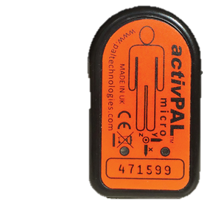
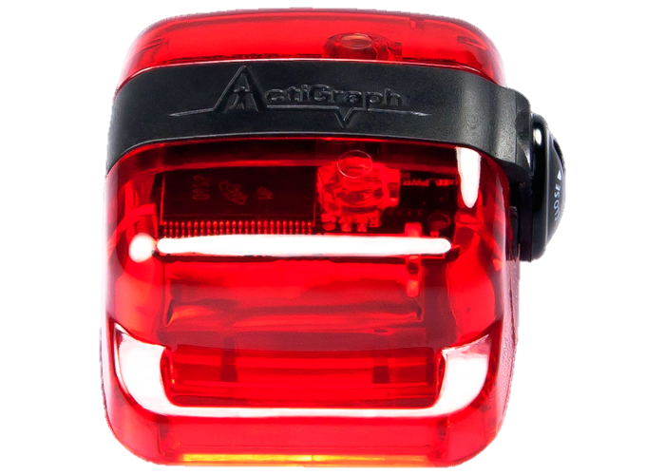
Validation Studies of Sedentary Behavior
Typically believed that the activPAL device = better measurement of sedentary behavior due to placement on thigh.
Sedentary behavior can be measured using the Actigraph (hip worn or wrist worn) and other devices using count thresholds and other inputs.
Lyden et al. MSSE, 2017.

Slide 10
Clinical Implications
CU-Anschutz Shoutout
Danielle Ostendorf, PhD and Victoria Catenacci, MD
Weight loss maintainers engage in lower amounts of total sedentary time compared to controls with obesity
Weight loss maintainers engage in ~1 fewer bout of sedentary behavior >30 minutes compared to controls with obesity
Weight loss maintainers break up their sedentary time ~6 times every hour which was more than controls with and without obesity.
Ostendorf et al. Obesity, 2018.

Slide 11
Future Directions
Recommendations/Guidelines around sedentary behavior
(WHO Guidelines announced in 2020)
What is the importance of sedentary behavior within context of other behaviors?
Strategies to improve congruence between devices

Slide 12
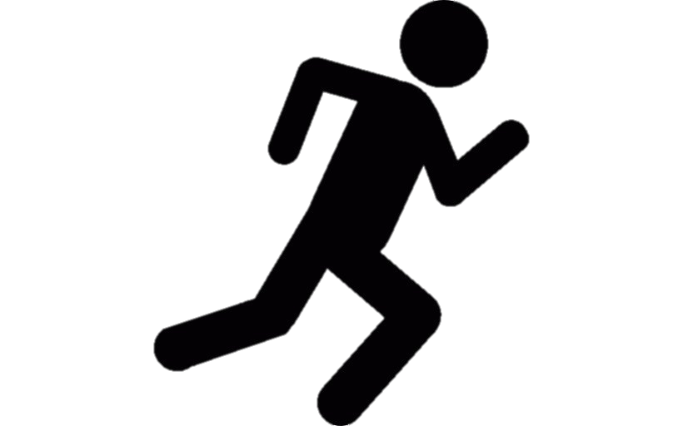
PHYSICAL ACTIVITY

Slide 13
Measures of Physical Activity
Wearables use posture and movement to determine variables related to physical activity (can also include heart rate, skin temperature, age, sex, etc.):
Volume (total counts, total steps, total energy expenditure)
Intensity (time spent in light, moderate, and vigorous intensity physical activity)
Timing (clock time, relative to waking, relative to another event)
Duration (time spent engaging in moderate to vigorous physical activity, time spent in bouts of >10 minutes)
Behavior (pattern recognition to determine type of activity)

Slide 14
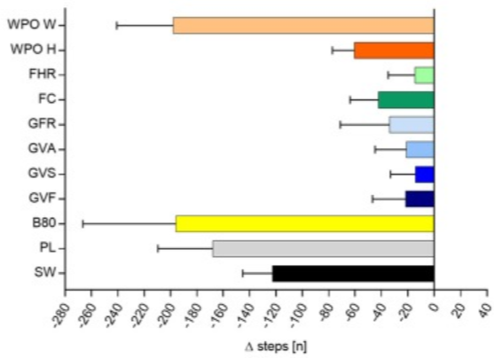
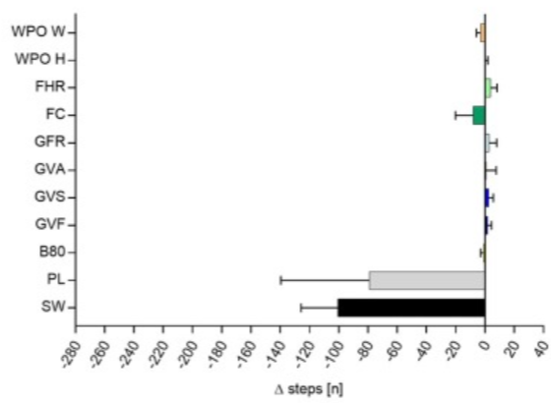
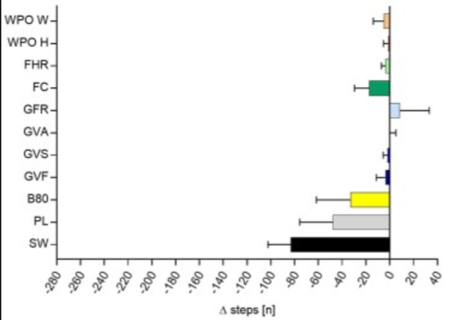
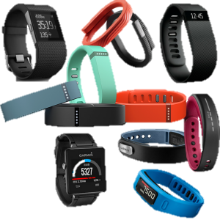
Validation Studies for Physical Activity
Wahl et al. Front Physiol 2017

Slide 15
Clinical Implications
CU-Anschutz Shoutout
Eleanor Cotton, MPH and Victoria Catenacci, MD
Creasy et al. Int J Obes 2021

Slide 16
Future Directions
Continuing to improve estimates of EE – translating to different populations
Timing and Consistency
Congruence between devices
Integrating All Behaviors

Slide 17
Thank You
Mentors, Collaborators, and Team Members
Shelby Panter, MS Jen Blankenship, PhD Rebecca Rosenberg, DO
Danielle Ostendorf, PhD Zhaoxing Pan, PhD Jaron Arbet, PhD
Laura Grau, MPH Liza Wayland, MA Kristen Bing, RD
Daniel Bessesen, MD Paul Hibbing, PhD Eleanor Cotton, MS
Kate Lyden, PhD Ed Melanson, PhD Victoria Catenacci, MD

